Slide 1
ST Engineering Manual
Admin Panel

Slide 2
Logging Into Admin Panel

Slide 3
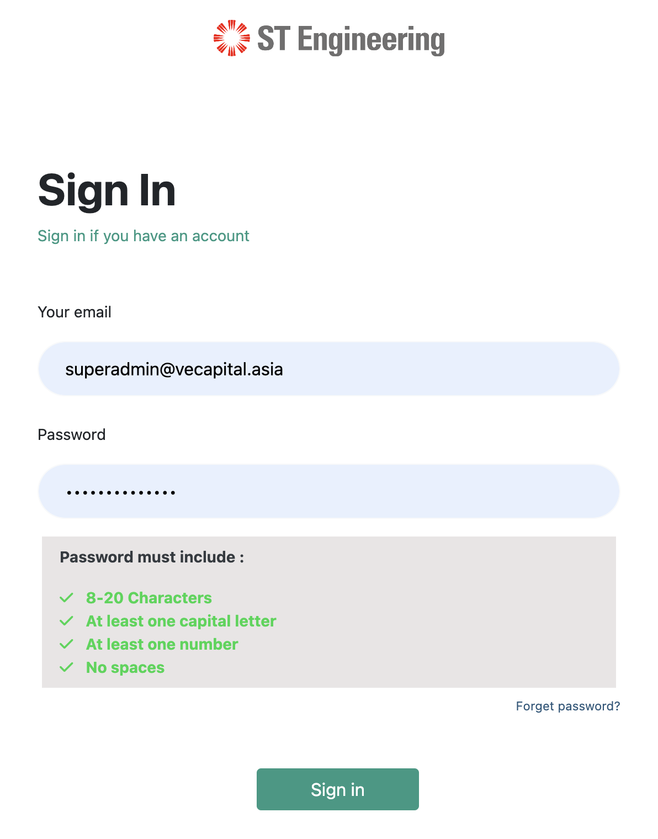
Logging Into Admin Panel
Step 1:
Head to https://lmsats.stengg.com/login
Step 2:
Type in your email
Step 3:
Type in your password and the password must meet the requirements below
Step 4:
Click Sign in

Slide 4
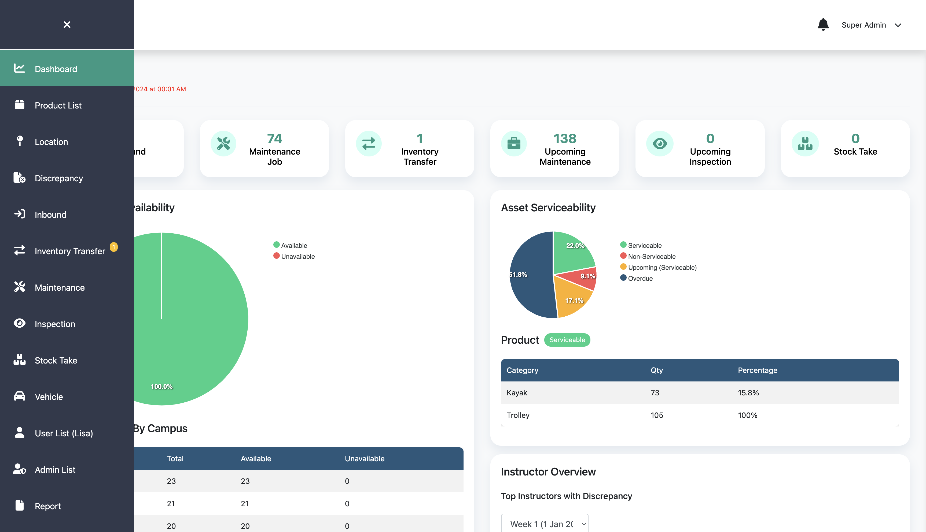
Overview of Admin Panel
This is the dashboard overview
After login, you will see this dashboard.
This is where you manage products, categories, uom, threshold and product logs
This is where you manage location, store and campus data
This is where you manage asset, job and condemn
This is where you manage inspection and inspection job
This is where you manage vehicle and type of vehicle
This is where you manage admin and role

Slide 5
Dashboard

Slide 6
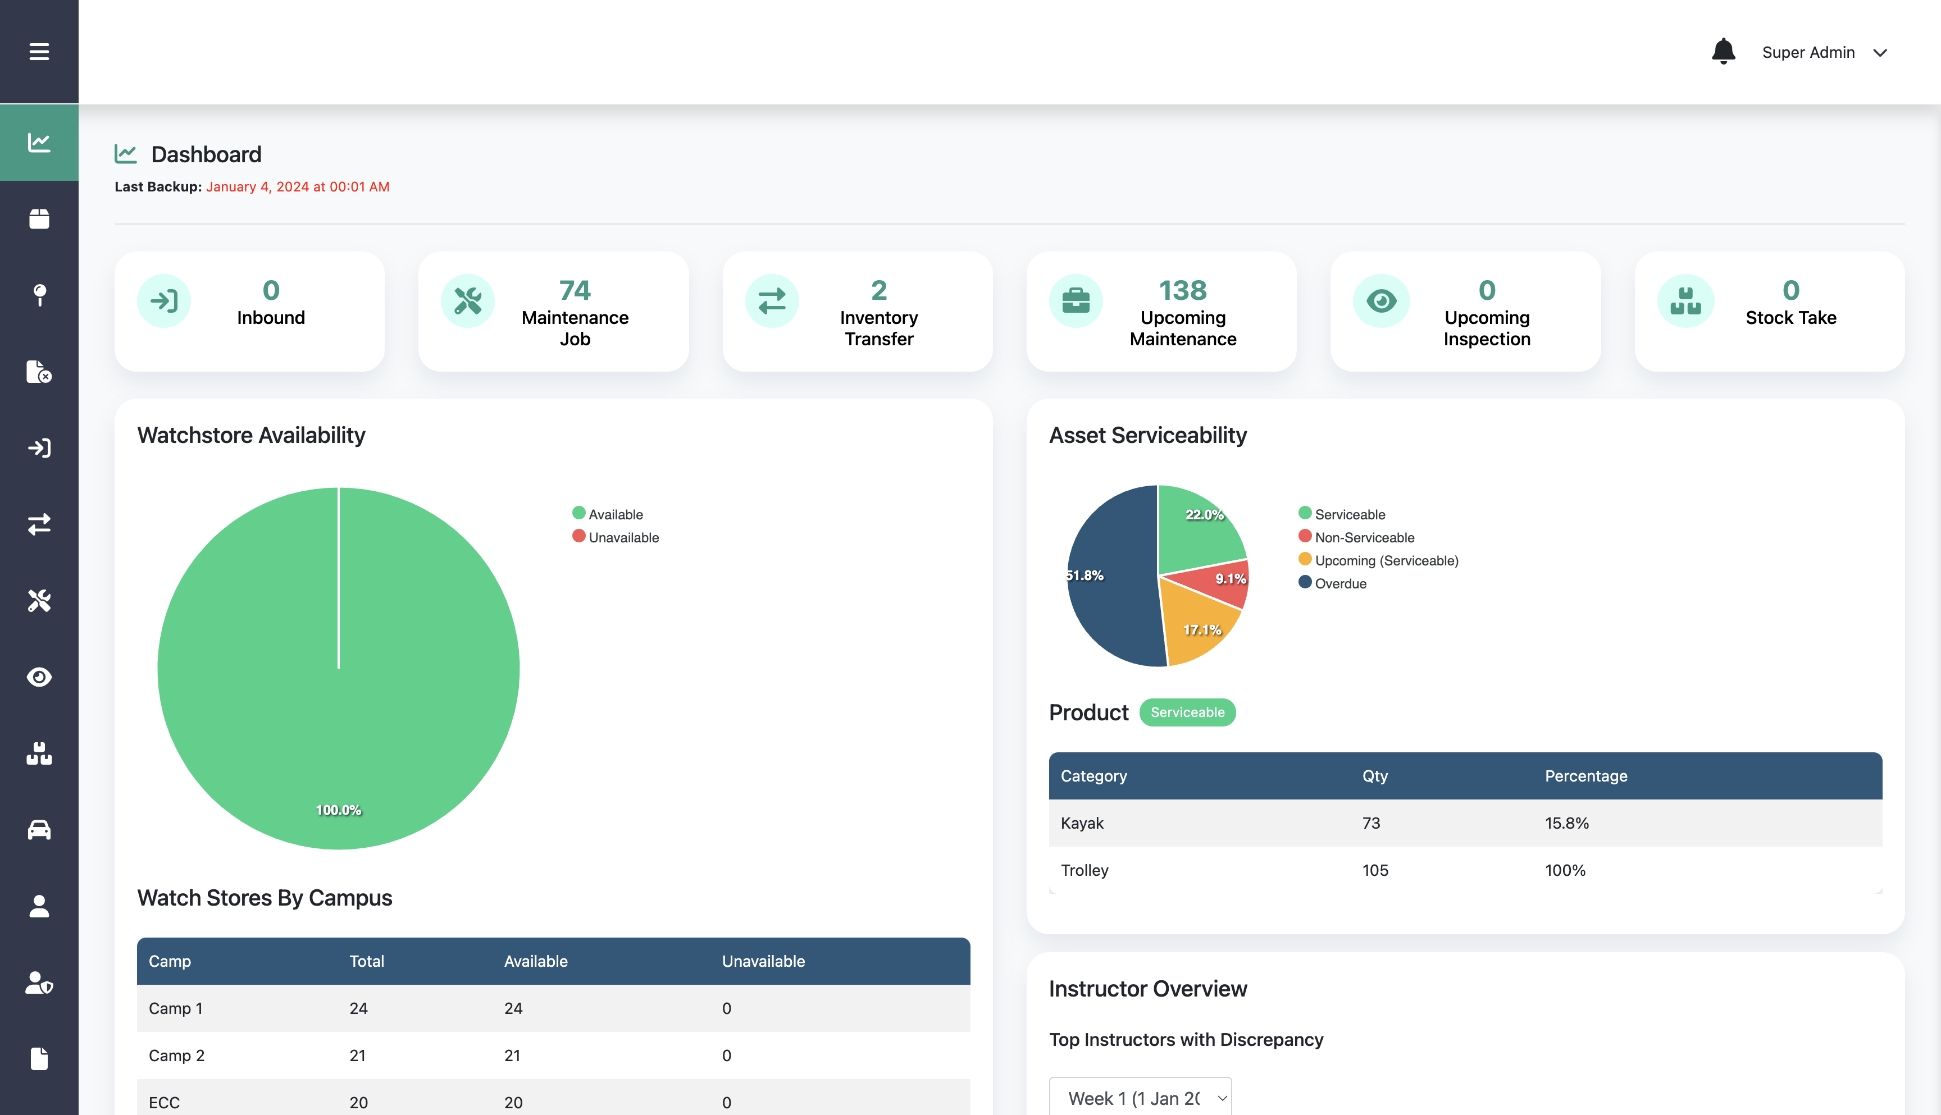
Dashboard
The dashboard page consists of watchstore availability, asset serviceability, inventory, assets, consumables, and movement rate data

Slide 7
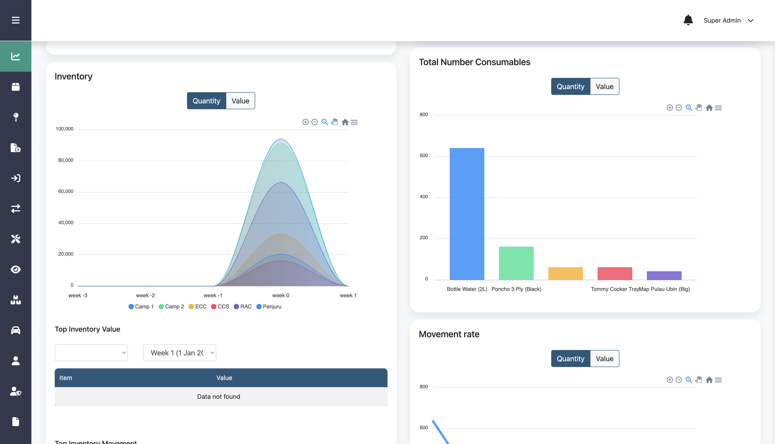
Dashboard
The dashboard page consists of watch store availability, asset serviceability, inventory, assets, consumables, and movement rate.

Slide 8
Creating New User

Slide 9
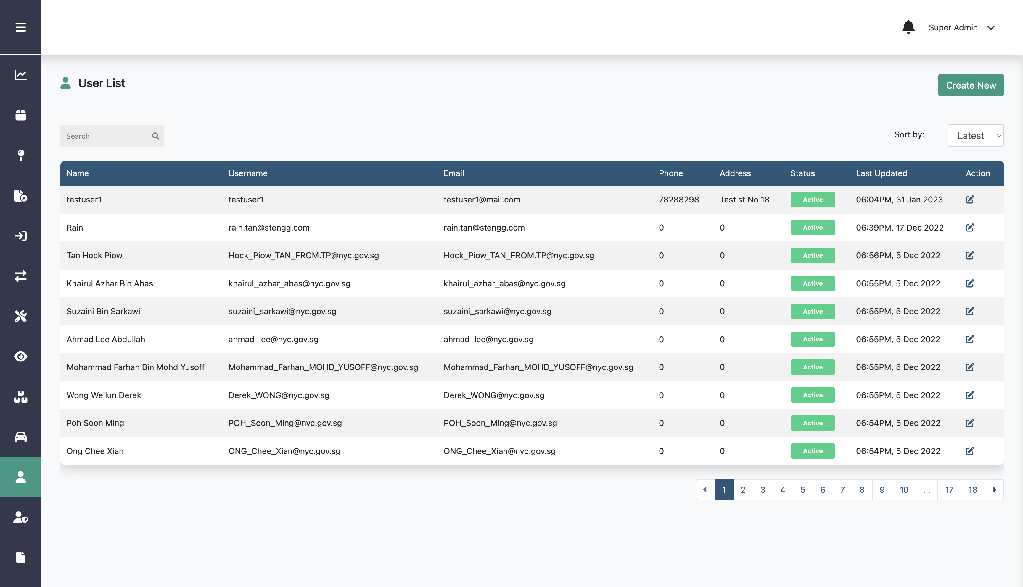
Creating New User
Step 2:
Click Create New
Step 1:
Click User List menu

Slide 10
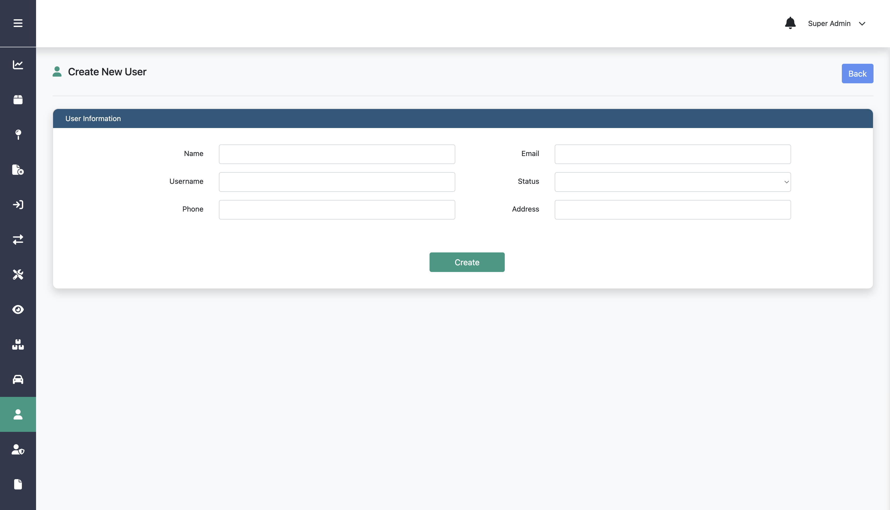
Creating New User
Step 3:
Fill in name, username, phone, email, status, and address
Step 4:
Click Create

Slide 11
Editing User

Slide 12
Editing User
Step 2:
Click this edit icon on a specific user
Step 1:
Click User List menu

Slide 13
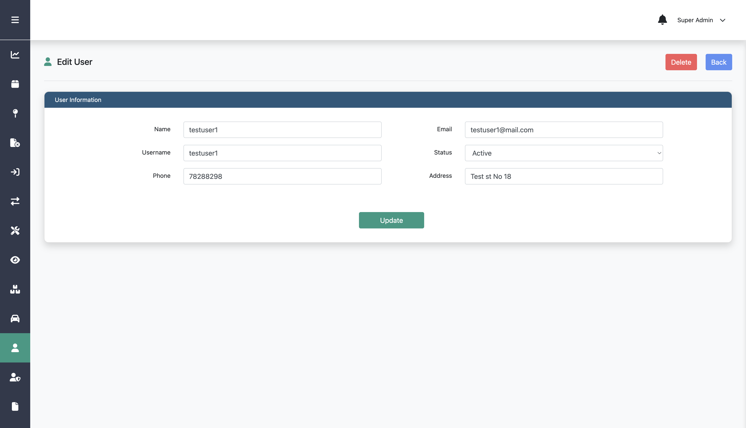
Editing User
Step 3:
Edit any information on the form
Step 4:
Click Update

Slide 14
Deleting User

Slide 15
Deleting User
Step 2:
Click this edit icon on a specific user
Step 1:
Click User List menu

Slide 16
Deleting User
Step 3:
Click Delete

Slide 17
Creating New Admin

Slide 18
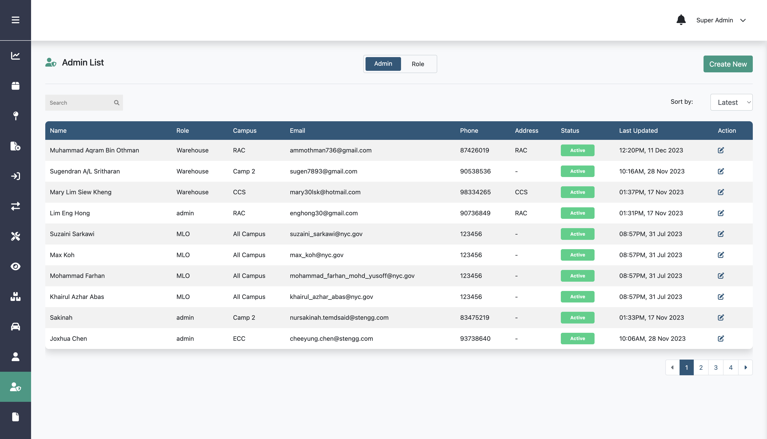
Creating New Admin
Step 2:
Click Create New
Step 1:
Click Admin List menu

Slide 19
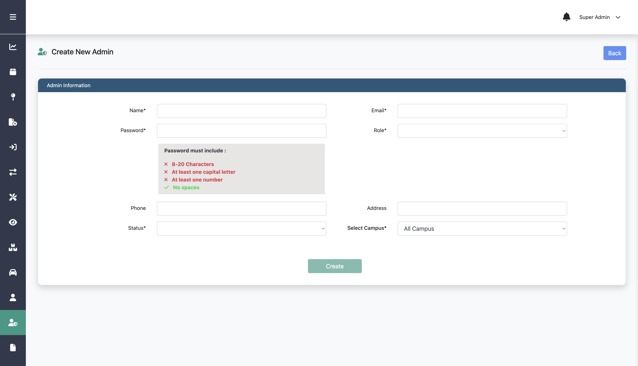
Creating New Admin
Step 3:
Fill in name, email, password, role, phone, address, status and campus
Step 4:
Click Create

Slide 20
Editing Admin

Slide 21
Editing Admin
Step 2:
Click this edit icon on a specific admin
Step 1:
Click Admin List menu

Slide 22
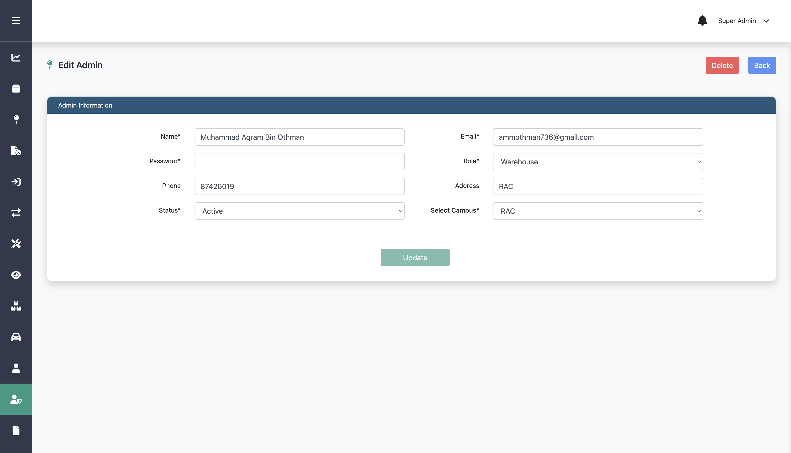
Editing Admin
Step 3:
Edit any information on the form
Step 4:
Click Update

Slide 23
Deleting Admin

Slide 24
Deleting Admin
Step 2:
Click this edit icon on a specific admin
Step 1:
Click Admin List menu

Slide 25
Deleting Admin
Step 3:
Click Delete

Slide 26
Creating New Role

Slide 27
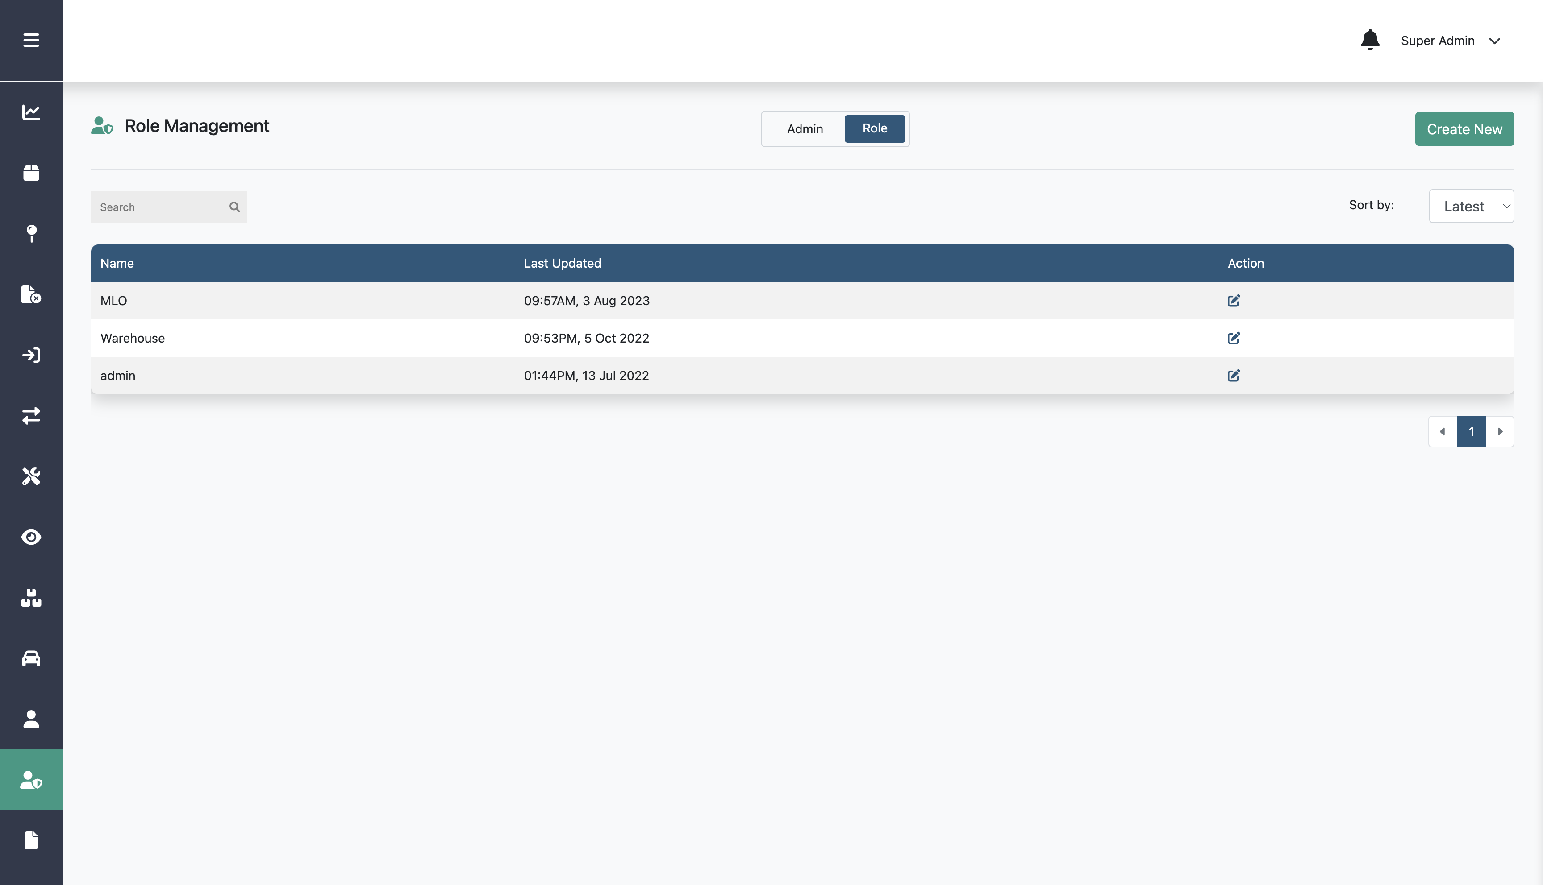
Creating New Role
Step 2:
Click Role
Step 3:
Click Create New
Step 1:
Click Admin List menu

Slide 28
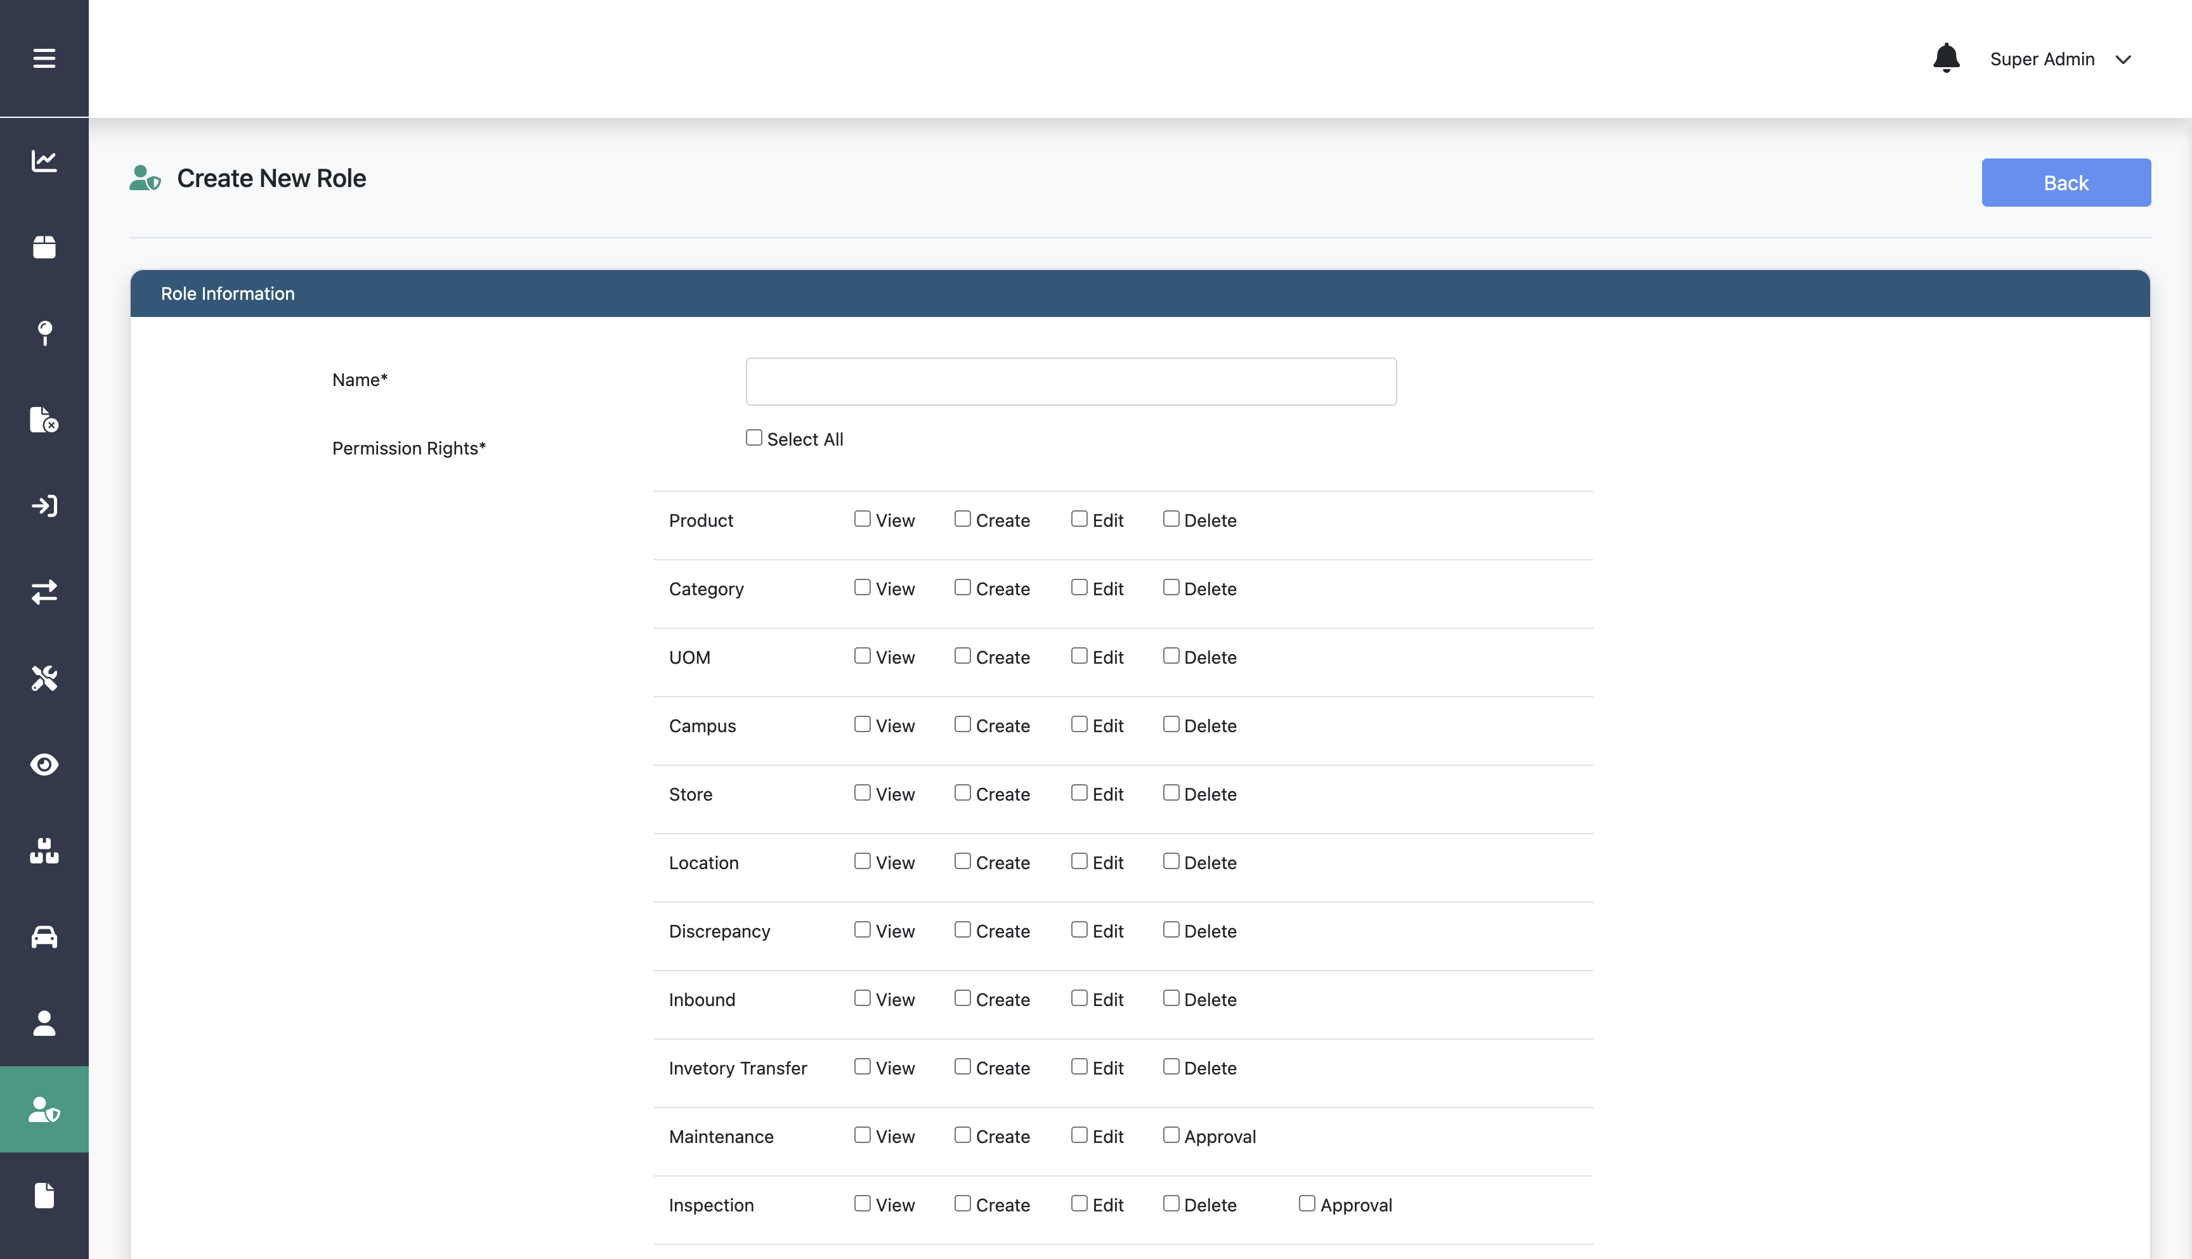
Creating New Role
Step 4:
Fill in name and check the permissions you want to include

Slide 29
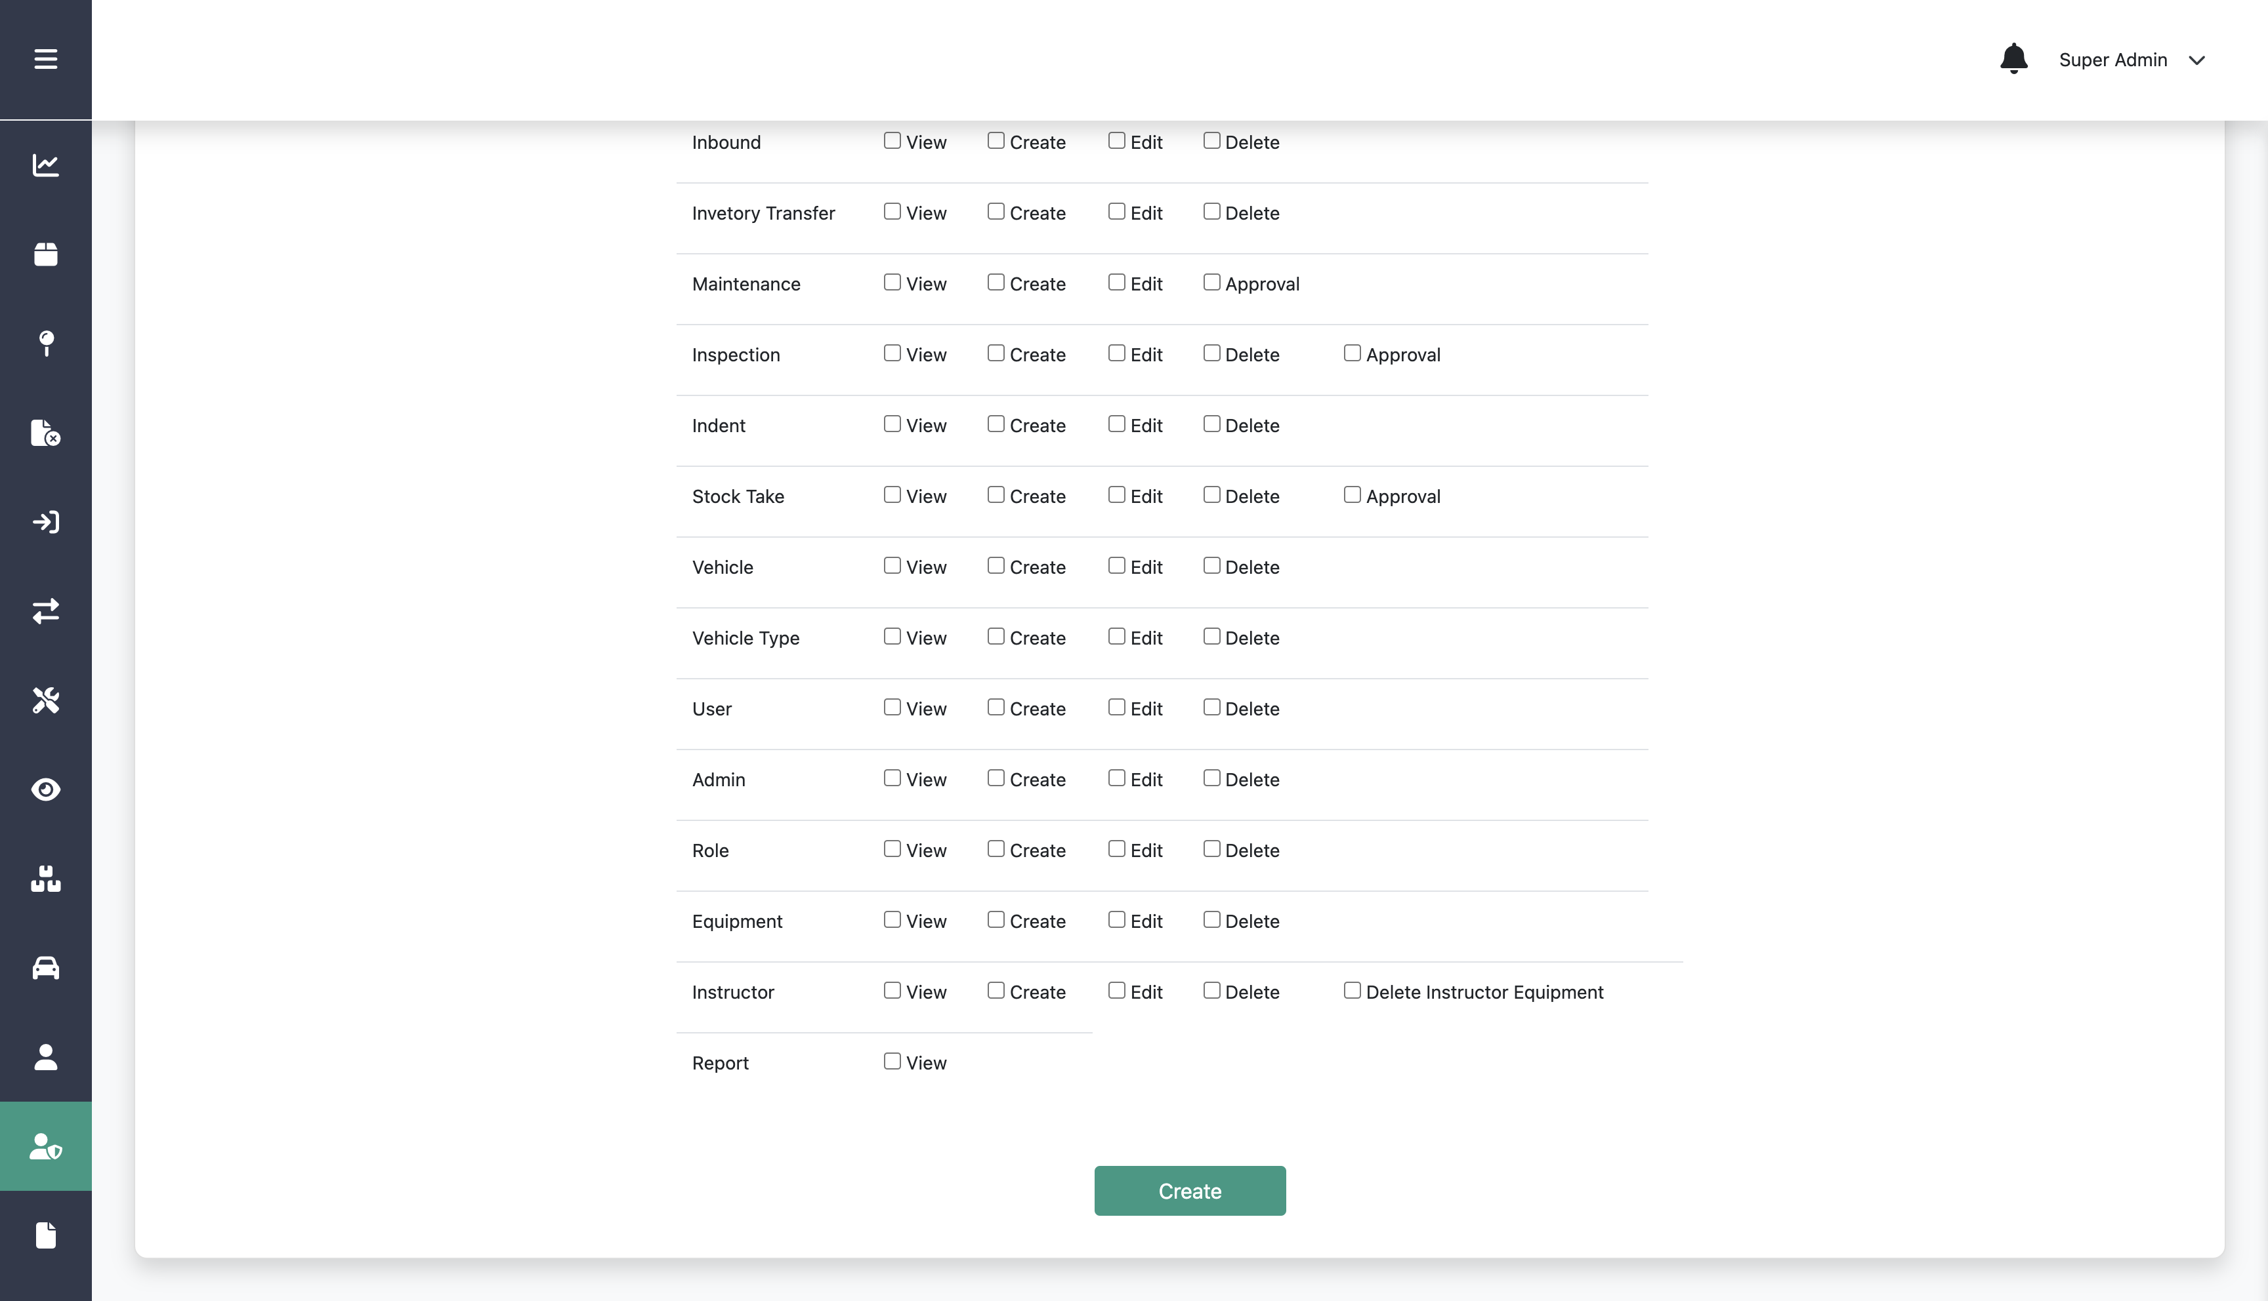
Creating New Role
Step 4:
Fill in name and check the permissions you want to include
Step 4:
Click Create
Step 5:
Click Create

Slide 30
Editing Role

Slide 31
Editing Role
Step 2:
Click Role
Step 3:
Click this edit icon on a specific role
Step 1:
Click Admin List menu

Slide 32
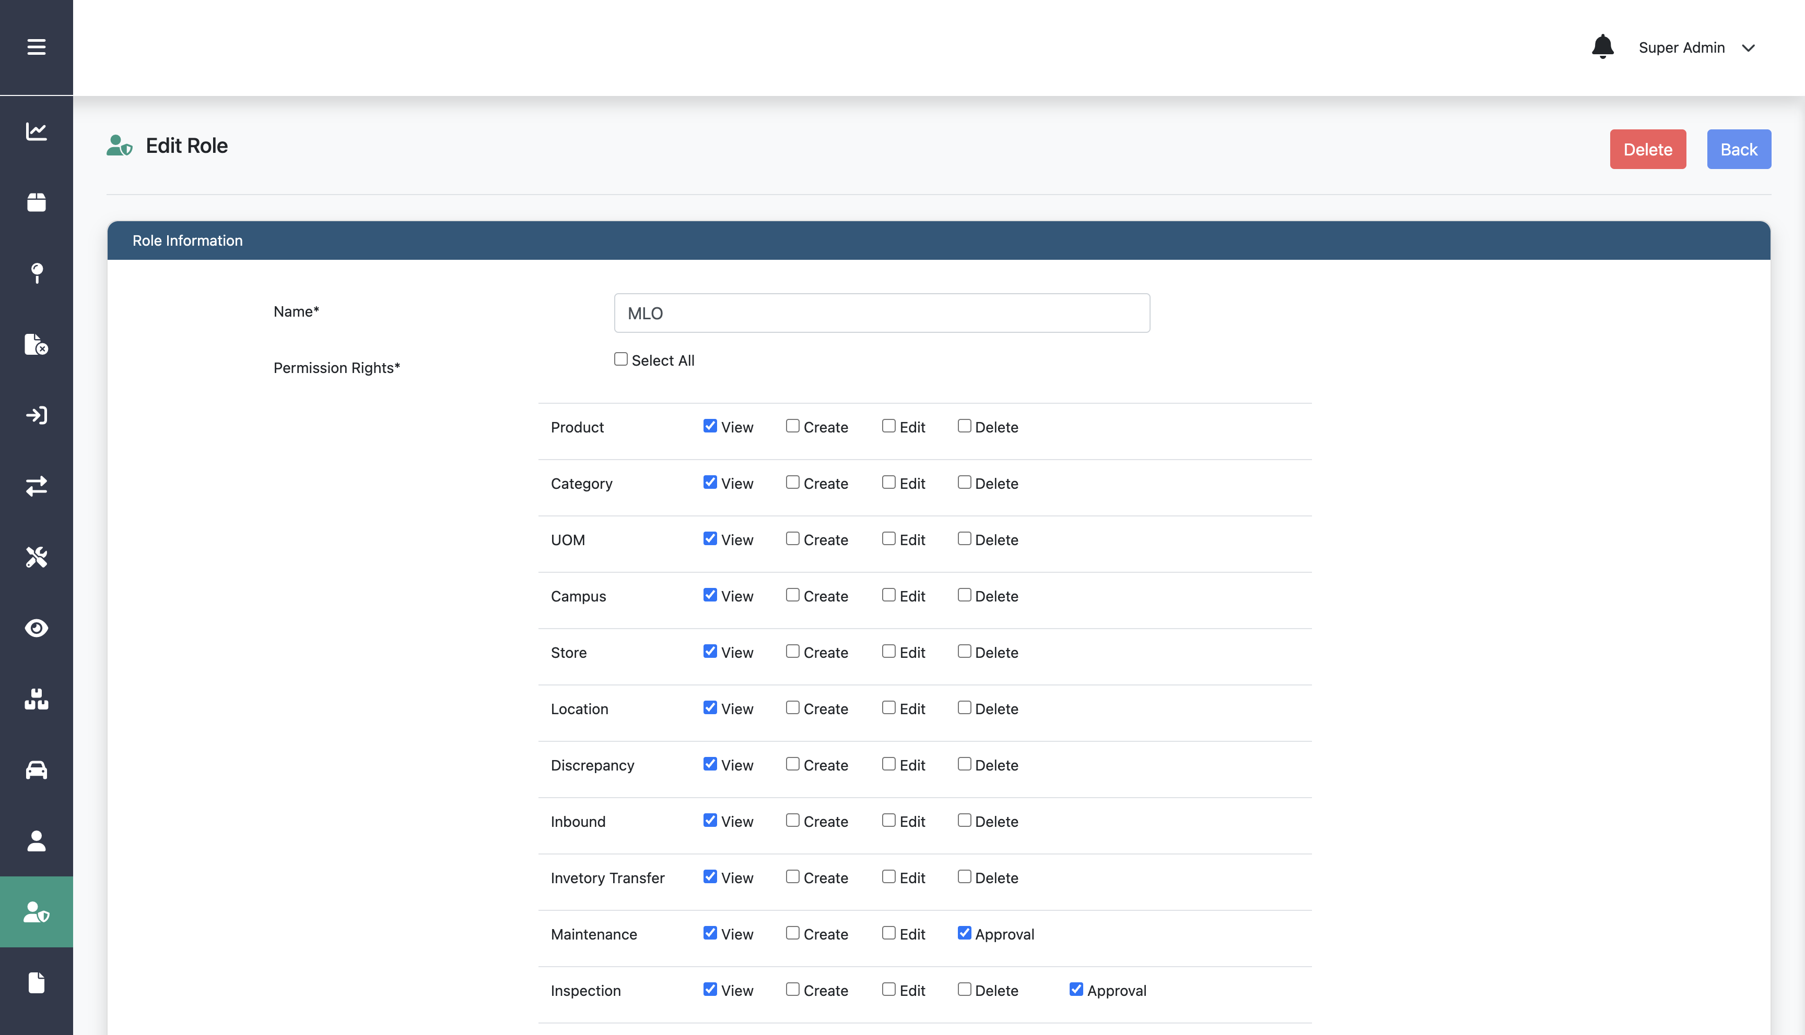
Editing Role
Step 4:
Edit any information on the form

Slide 33
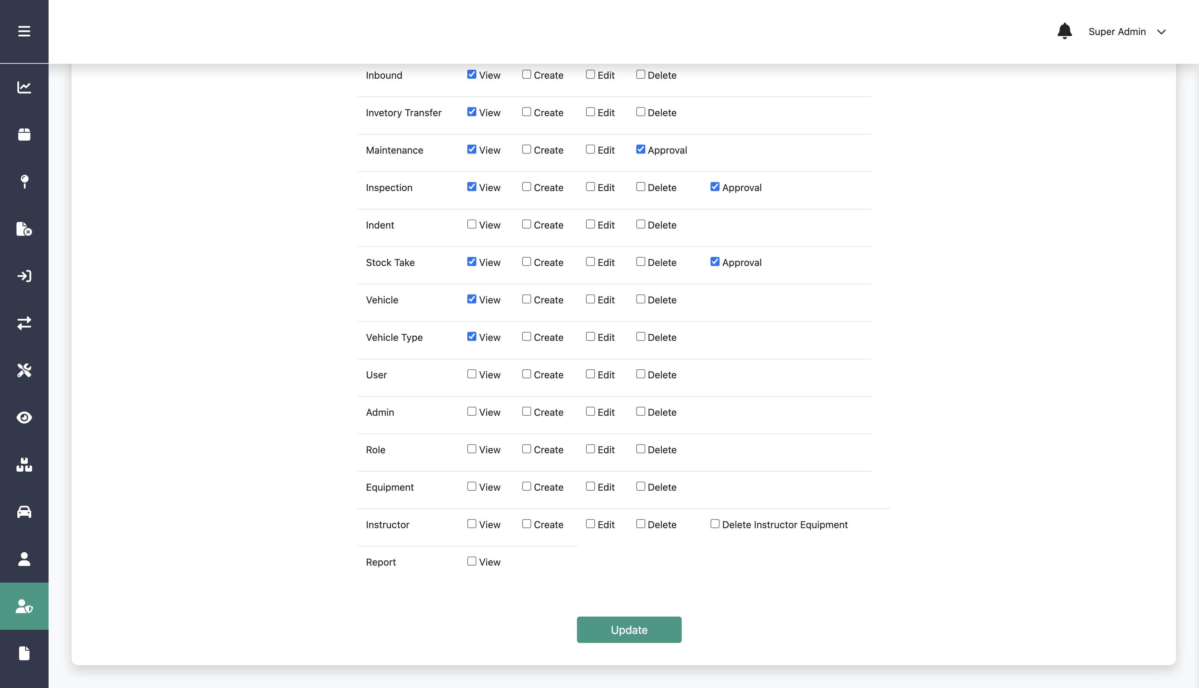
Editing Role
Step 3:
Edit any information on the form
Step 4:
Click Update
Step 5:
Click Update

Slide 34
Deleting Role

Slide 35
Deleting Role
Step 2:
Click Role
Step 3:
Click this edit icon on a specific role
Step 1:
Click Admin List menu

Slide 36
Deleting Role
Step 4:
Click Delete

Slide 37
Creating New Product

Slide 38
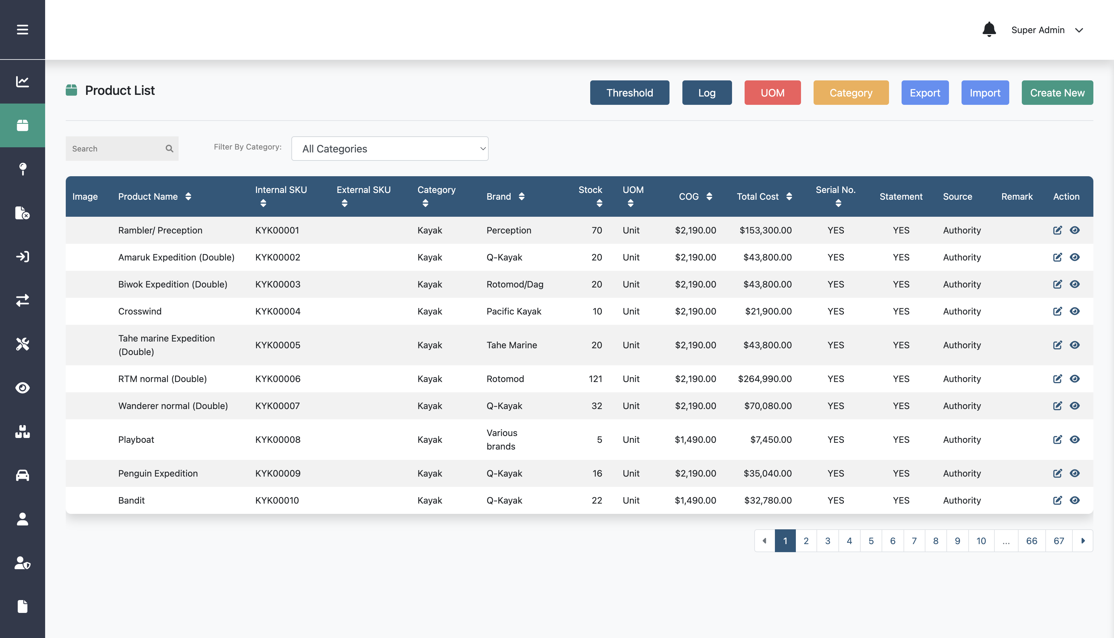
Creating New Product
Step 1:
Click Product List menu
Step 2:
Click Create New

Slide 39
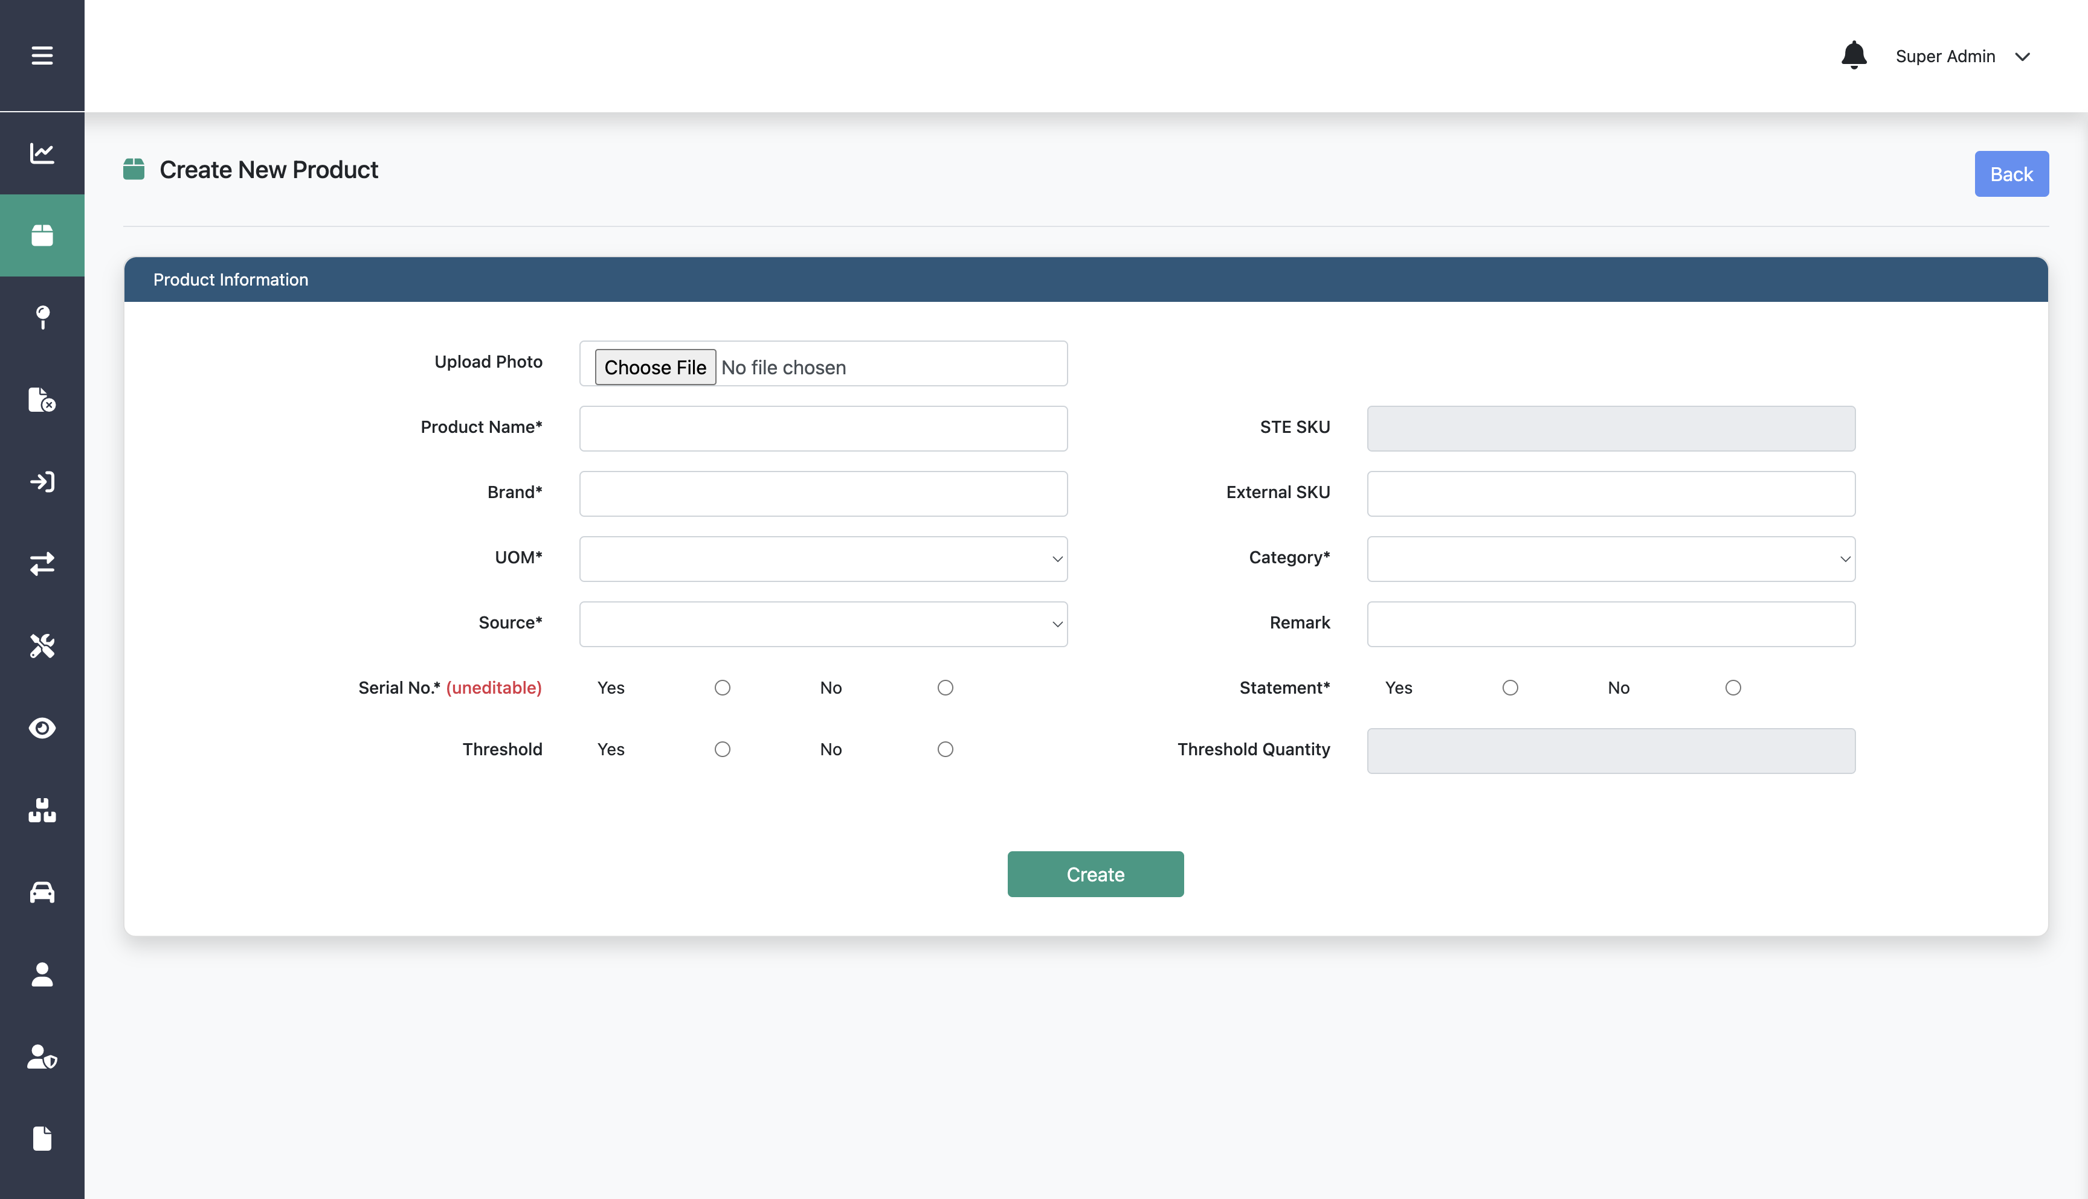
Creating New Product
Step 3:
Fill in product name, brand, and the other data
Step 4:
Click Create

Slide 40
Importing Product

Slide 41
Importing Product
Step 1:
Click Product List menu
Step 2:
Click Import

Slide 42
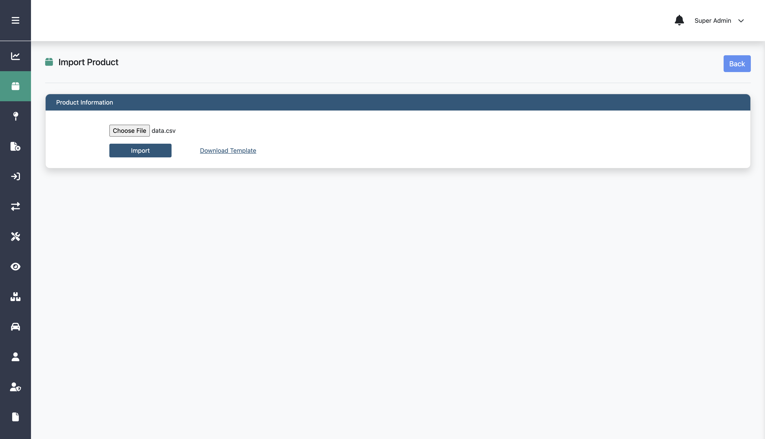
Importing Product
Step 3:
Upload the csv file that include the data
Option:
You can download the csv template
Step 4:
Click Import

Slide 43
Editing Product

Slide 44
Editing Product
Step 1:
Click Product List menu
Step 2:
Click this edit icon on a specific product

Slide 45
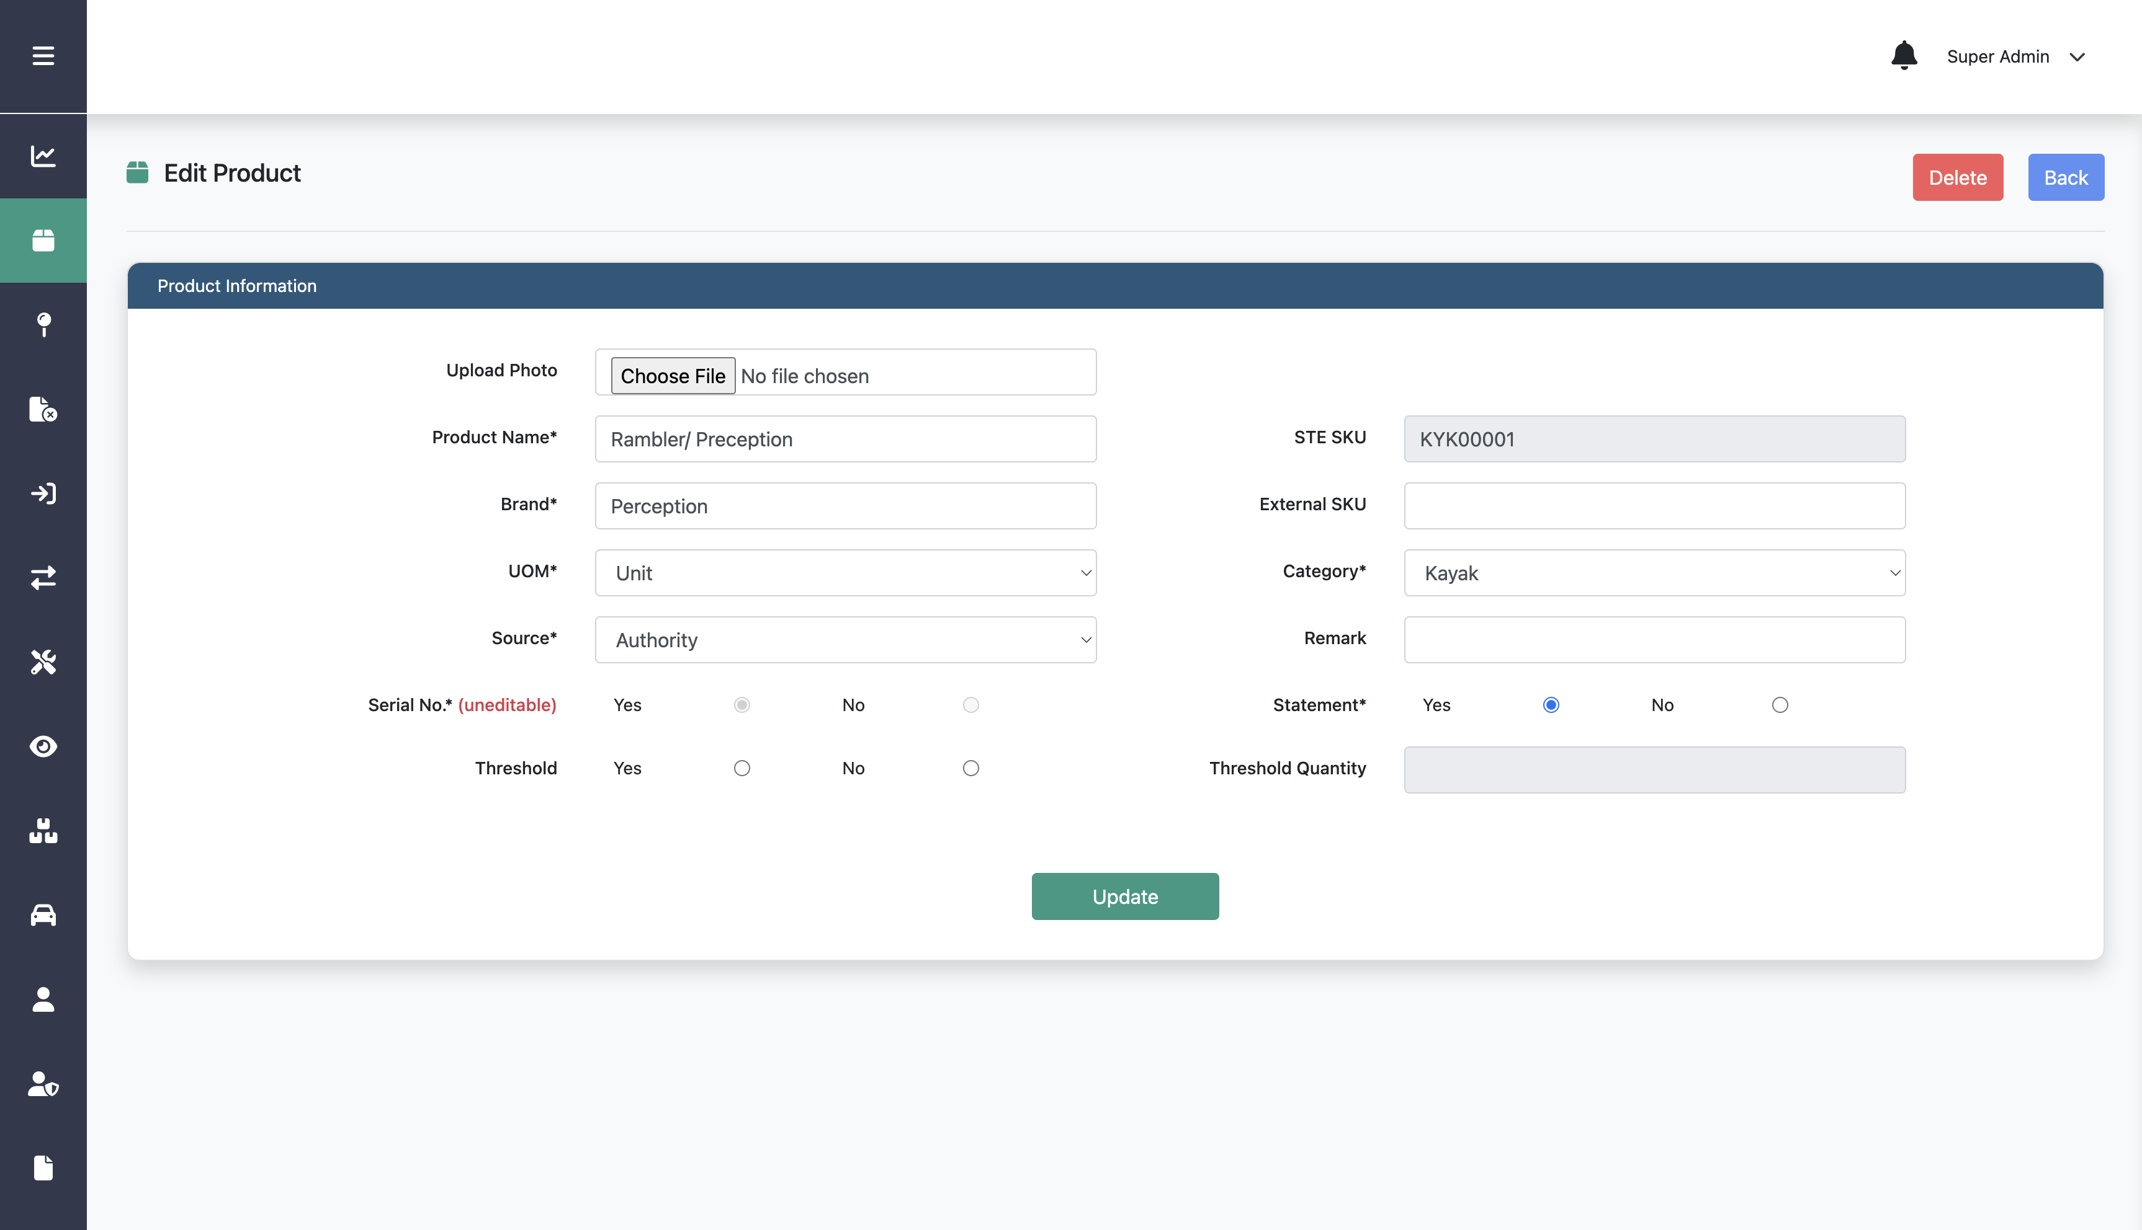
Editing Product
Step 3:
Edit any information on the form
Step 4:
Click Update

Slide 46
Deleting Product

Slide 47
Deleting Product
Step 1:
Click Product List menu
Step 2:
Click this edit icon on a specific product

Slide 48
Deleting Product
Step 3:
Click Delete

Slide 49
Creating New UOM

Slide 50
Creating New UOM
Step 1:
Click Product List menu
Step 2:
Click UOM

Slide 51
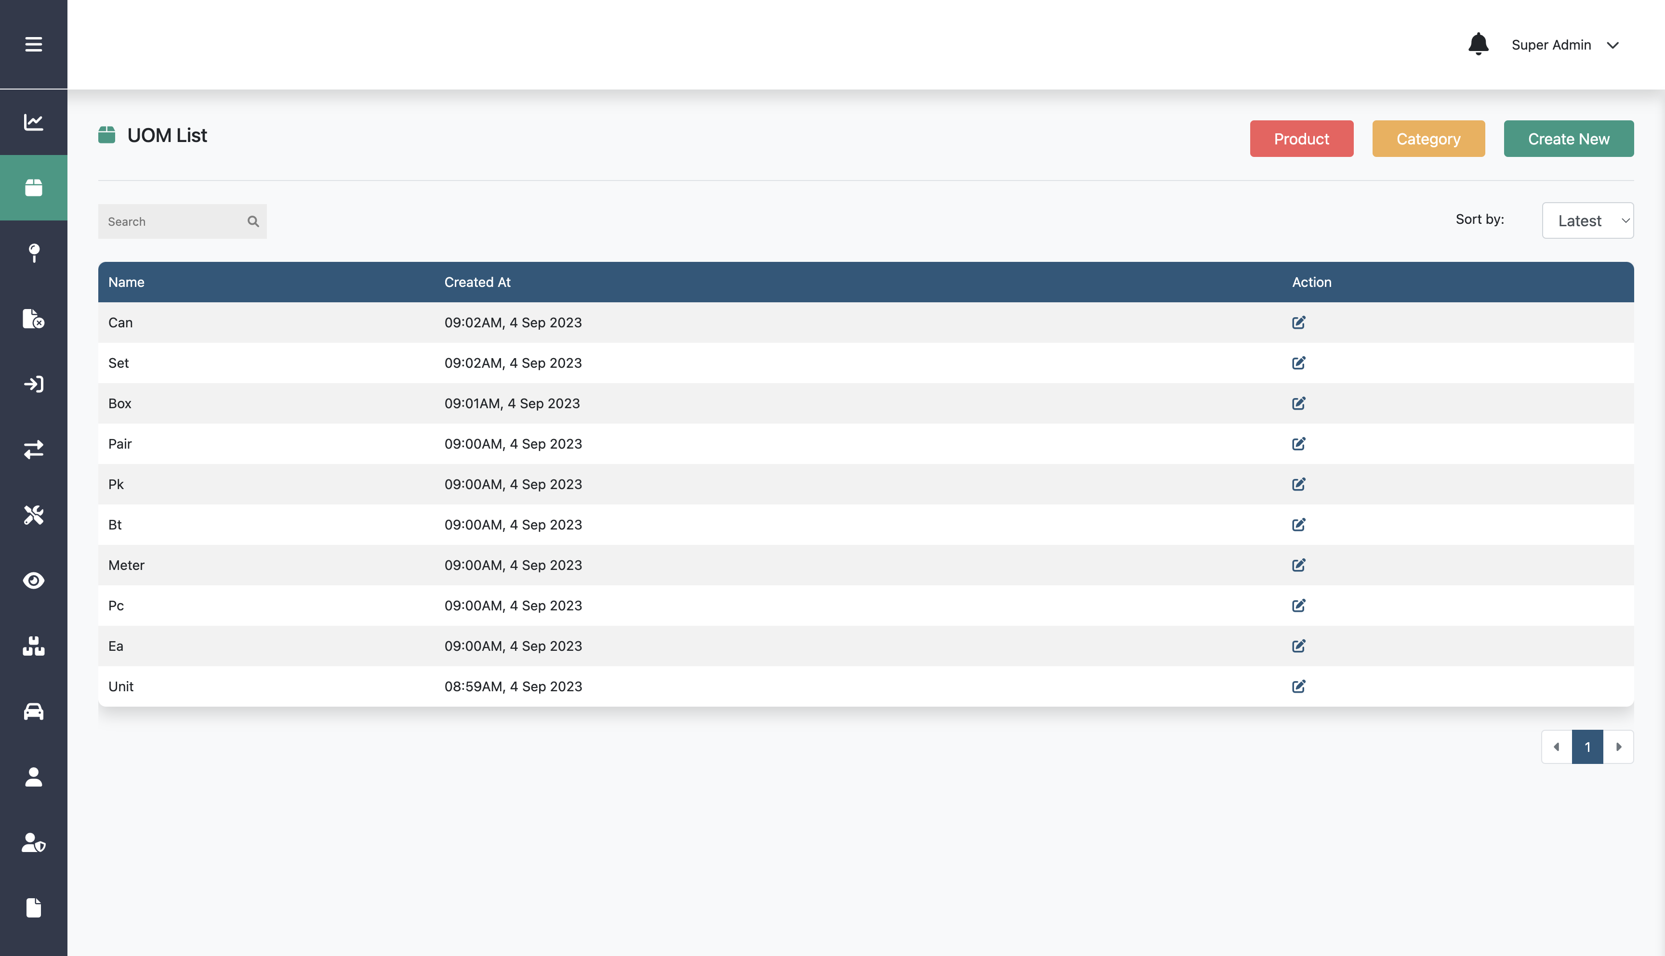
Creating New UOM
Step 3:
Click Create New

Slide 52
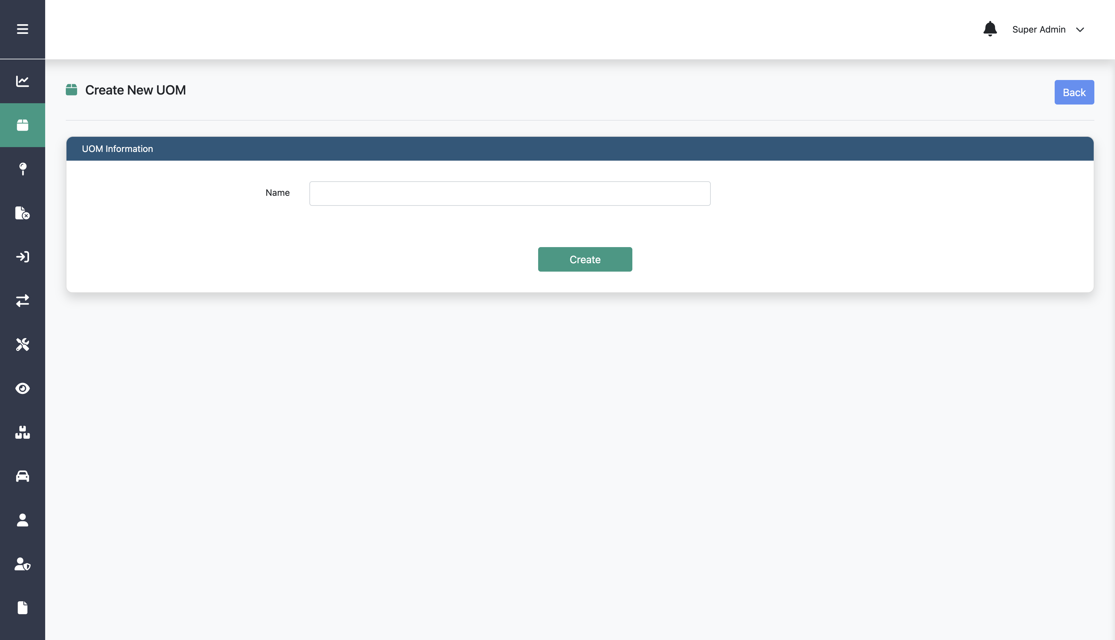
Creating New UOM
Step 4:
Fill in name
Step 5:
Click Create

Slide 53
Editing UOM

Slide 54
Editing UOM
Step 1:
Click Product List menu
Step 2:
Click UOM

Slide 55
Editing UOM
Step 3:
Fill in product name, brand, and the other data
Step 3:
Click this edit icon on a specific UOM
Step 4:
Click Create

Slide 56
Editing UOM
Step 4:
Edit information on the form
Step 5:
Click Update

Slide 57
Creating New Category

Slide 58
Creating New Category
Step 1:
Click Product List menu
Step 2:
Click Category

Slide 59
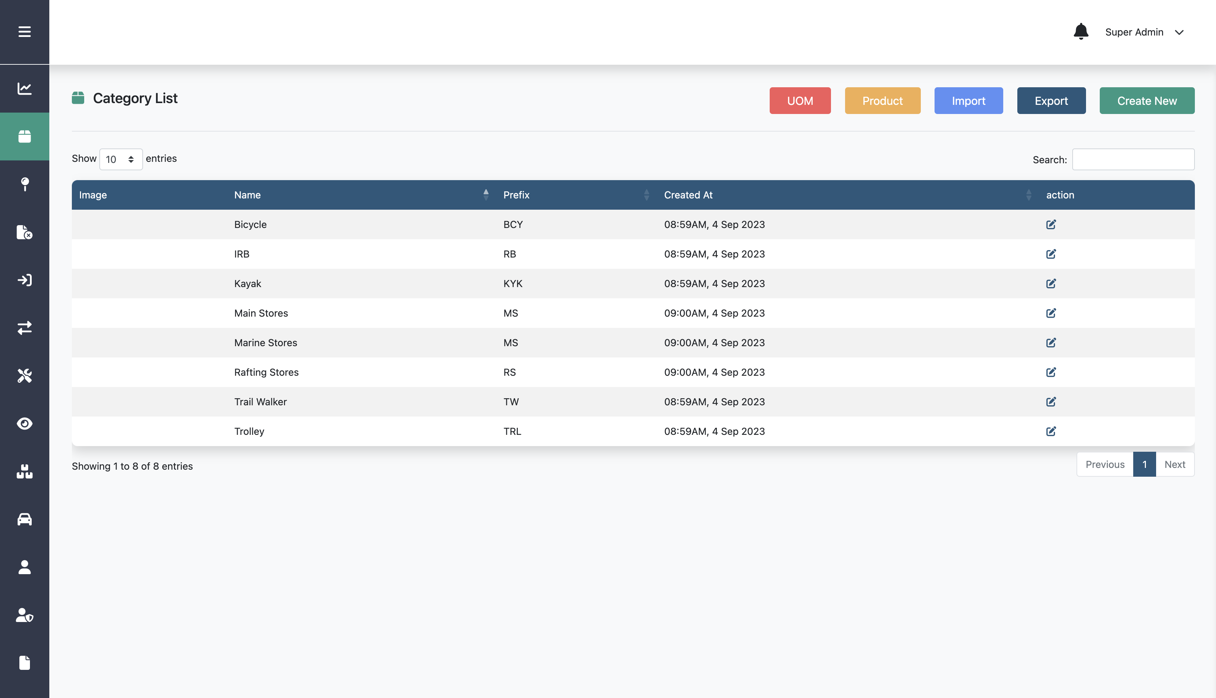
Creating New Category
Step 3:
Click Create New

Slide 60
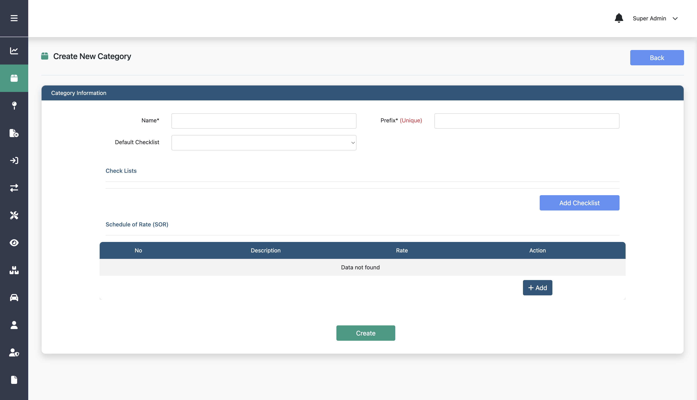
Creating New Category
Step 4:
Fill in category name, prefix, and the other data
Step 5:
Click Create

Slide 61
Importing Category

Slide 62
Importing Category
Step 1:
Click Product List menu
Step 2:
Click Category

Slide 63
Importing Category
Step 3:
Click Import

Slide 64
Importing Category
Step 4:
Upload the csv file that include the data
Option:
You can download the csv template
Step 5:
Click Import

Slide 65
Editing Category

Slide 66
Editing Category
Step 1:
Click Product List menu
Step 2:
Click Category

Slide 67
Editing Category
Step 3:
Click this edit icon on a specific category

Slide 68
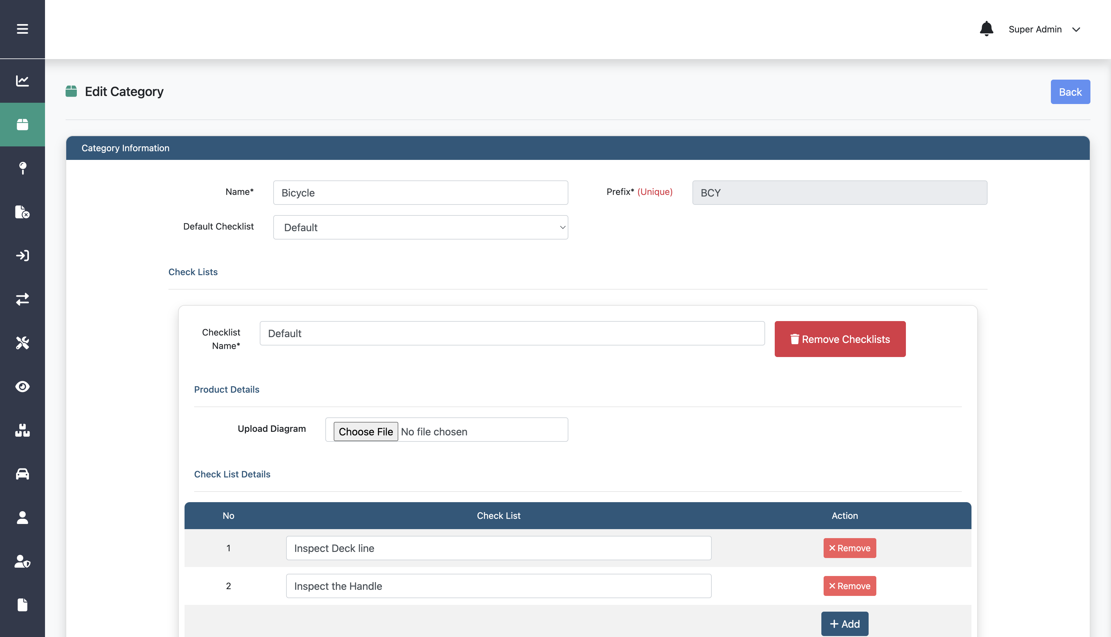
Editing Category
Step 4:
Edit any information on the form

Slide 69
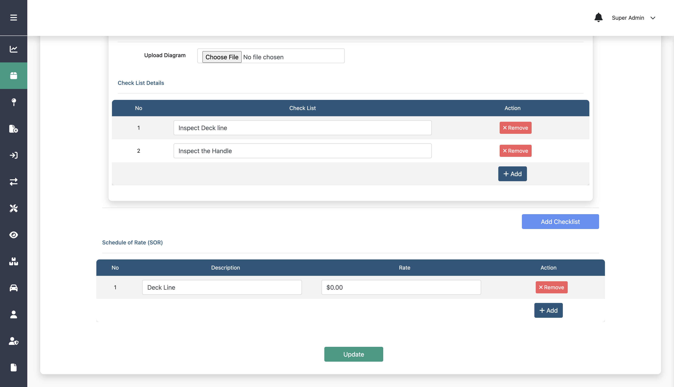
Editing Category
Step 5:
Click Update

Slide 70
Creating New Location

Slide 71
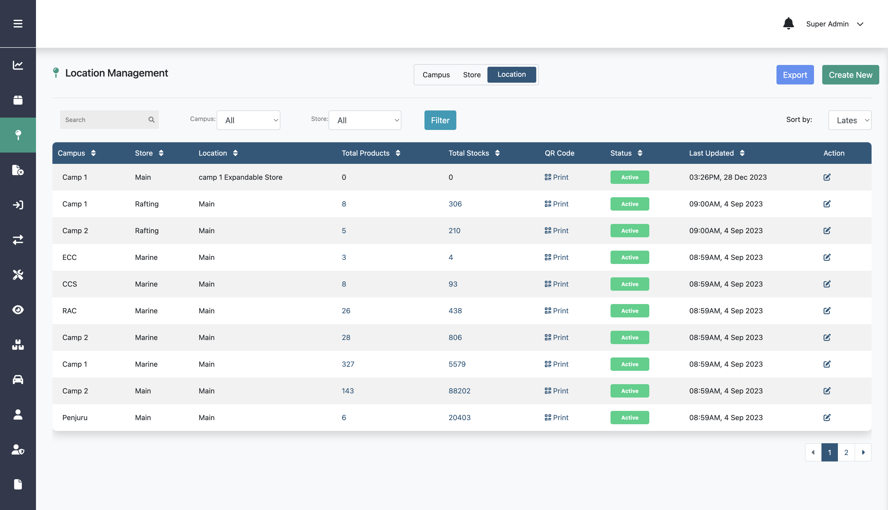
Creating New Location
Step 1:
Step 2:
Click Location menu
Click Create New

Slide 72
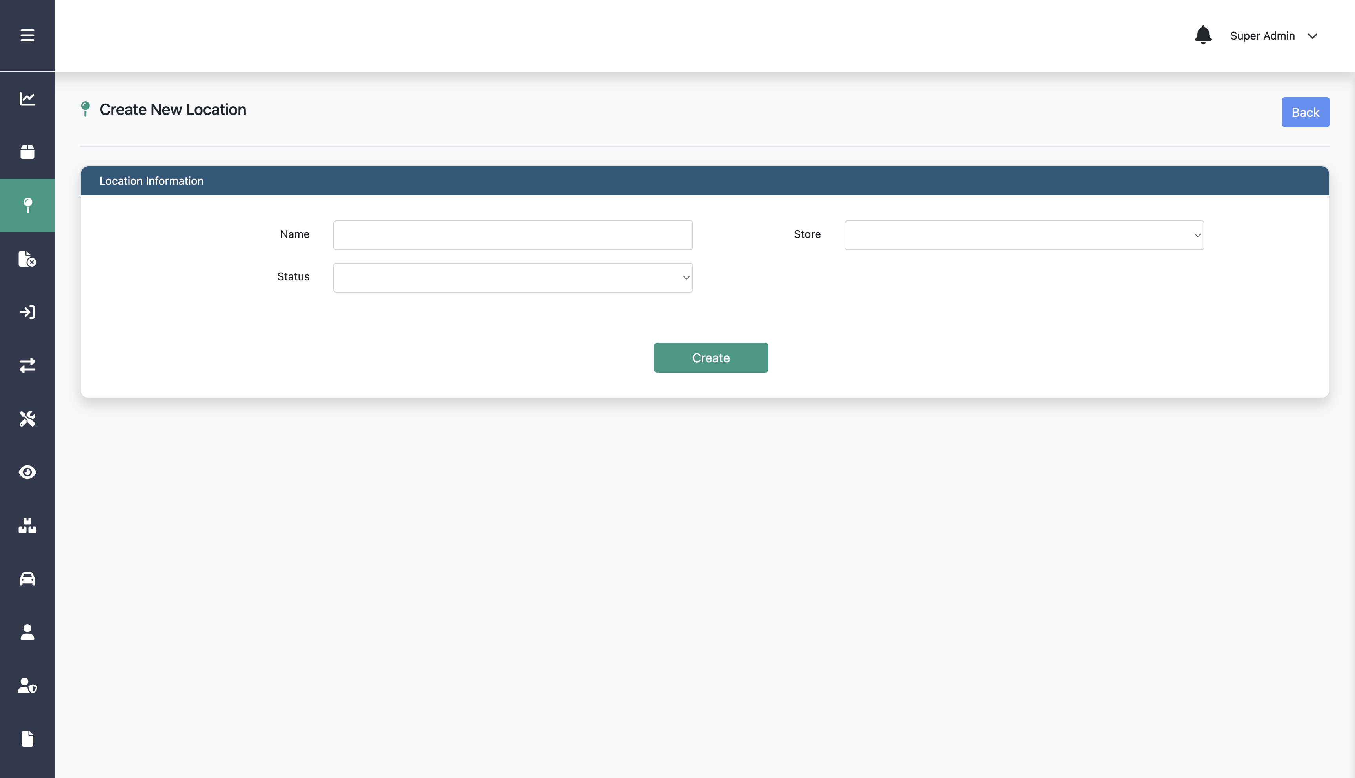
Creating New Location
Step 3:
Fill in name, store, and status
Step 4:
Click Create

Slide 73
Editing Location

Slide 74
Editing Location
Step 1:
Click Location menu
Step 2:
Click this edit icon on a specific location

Slide 75
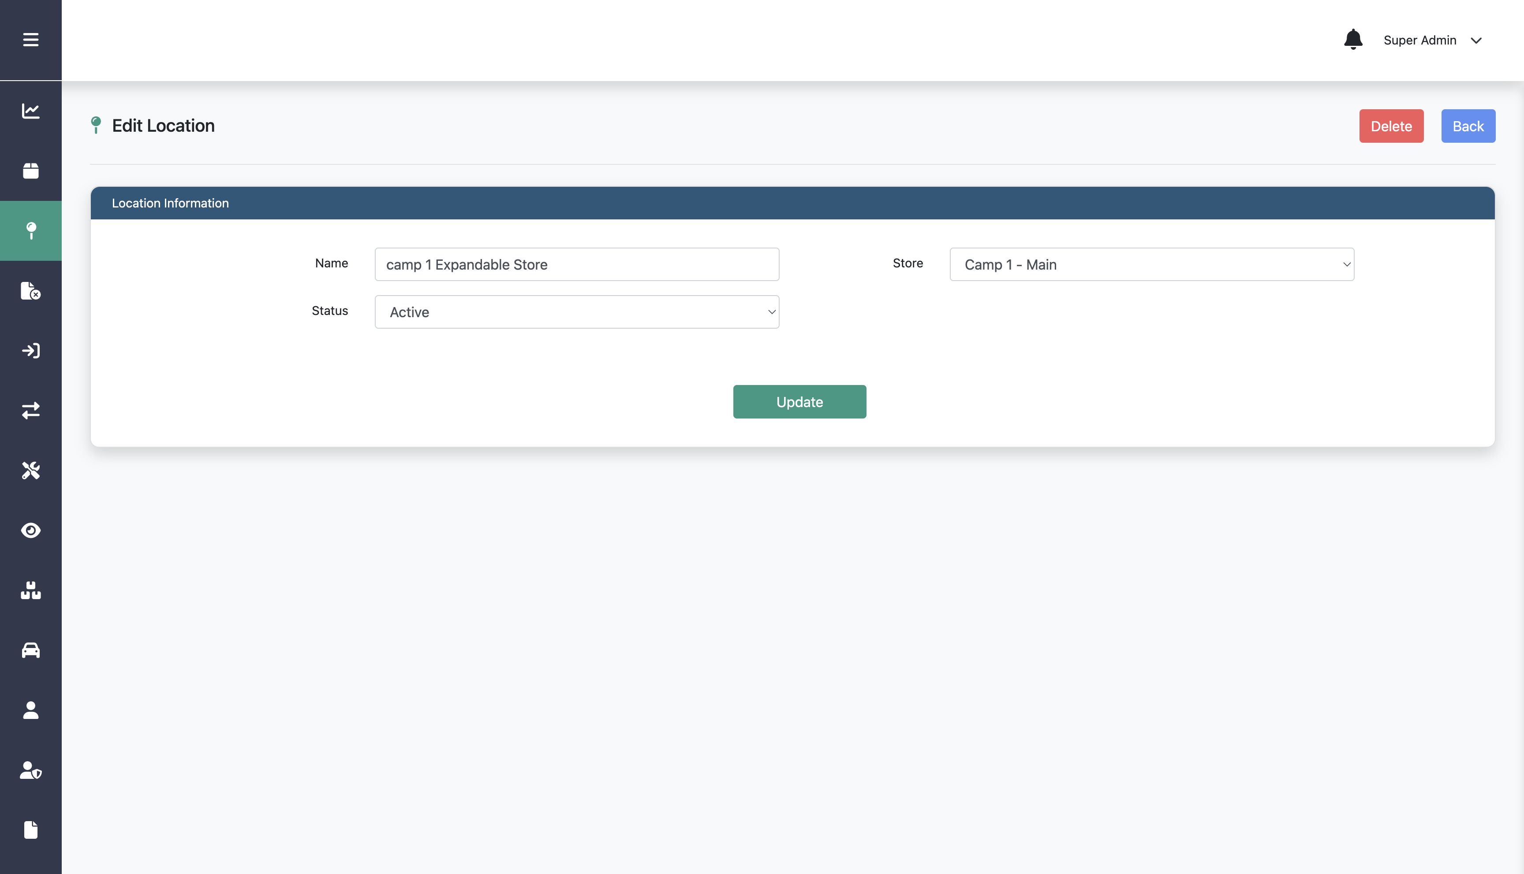
Editing Location
Step 3:
Edit any information on the form
Step 4:
Click Update

Slide 76
Deleting Location

Slide 77
Deleting Location
Step 1:
Click Location menu
Step 2:
Click this edit icon on a specific location

Slide 78
Deleting Location
Step 3:
Click Delete

Slide 79
Creating New Store

Slide 80
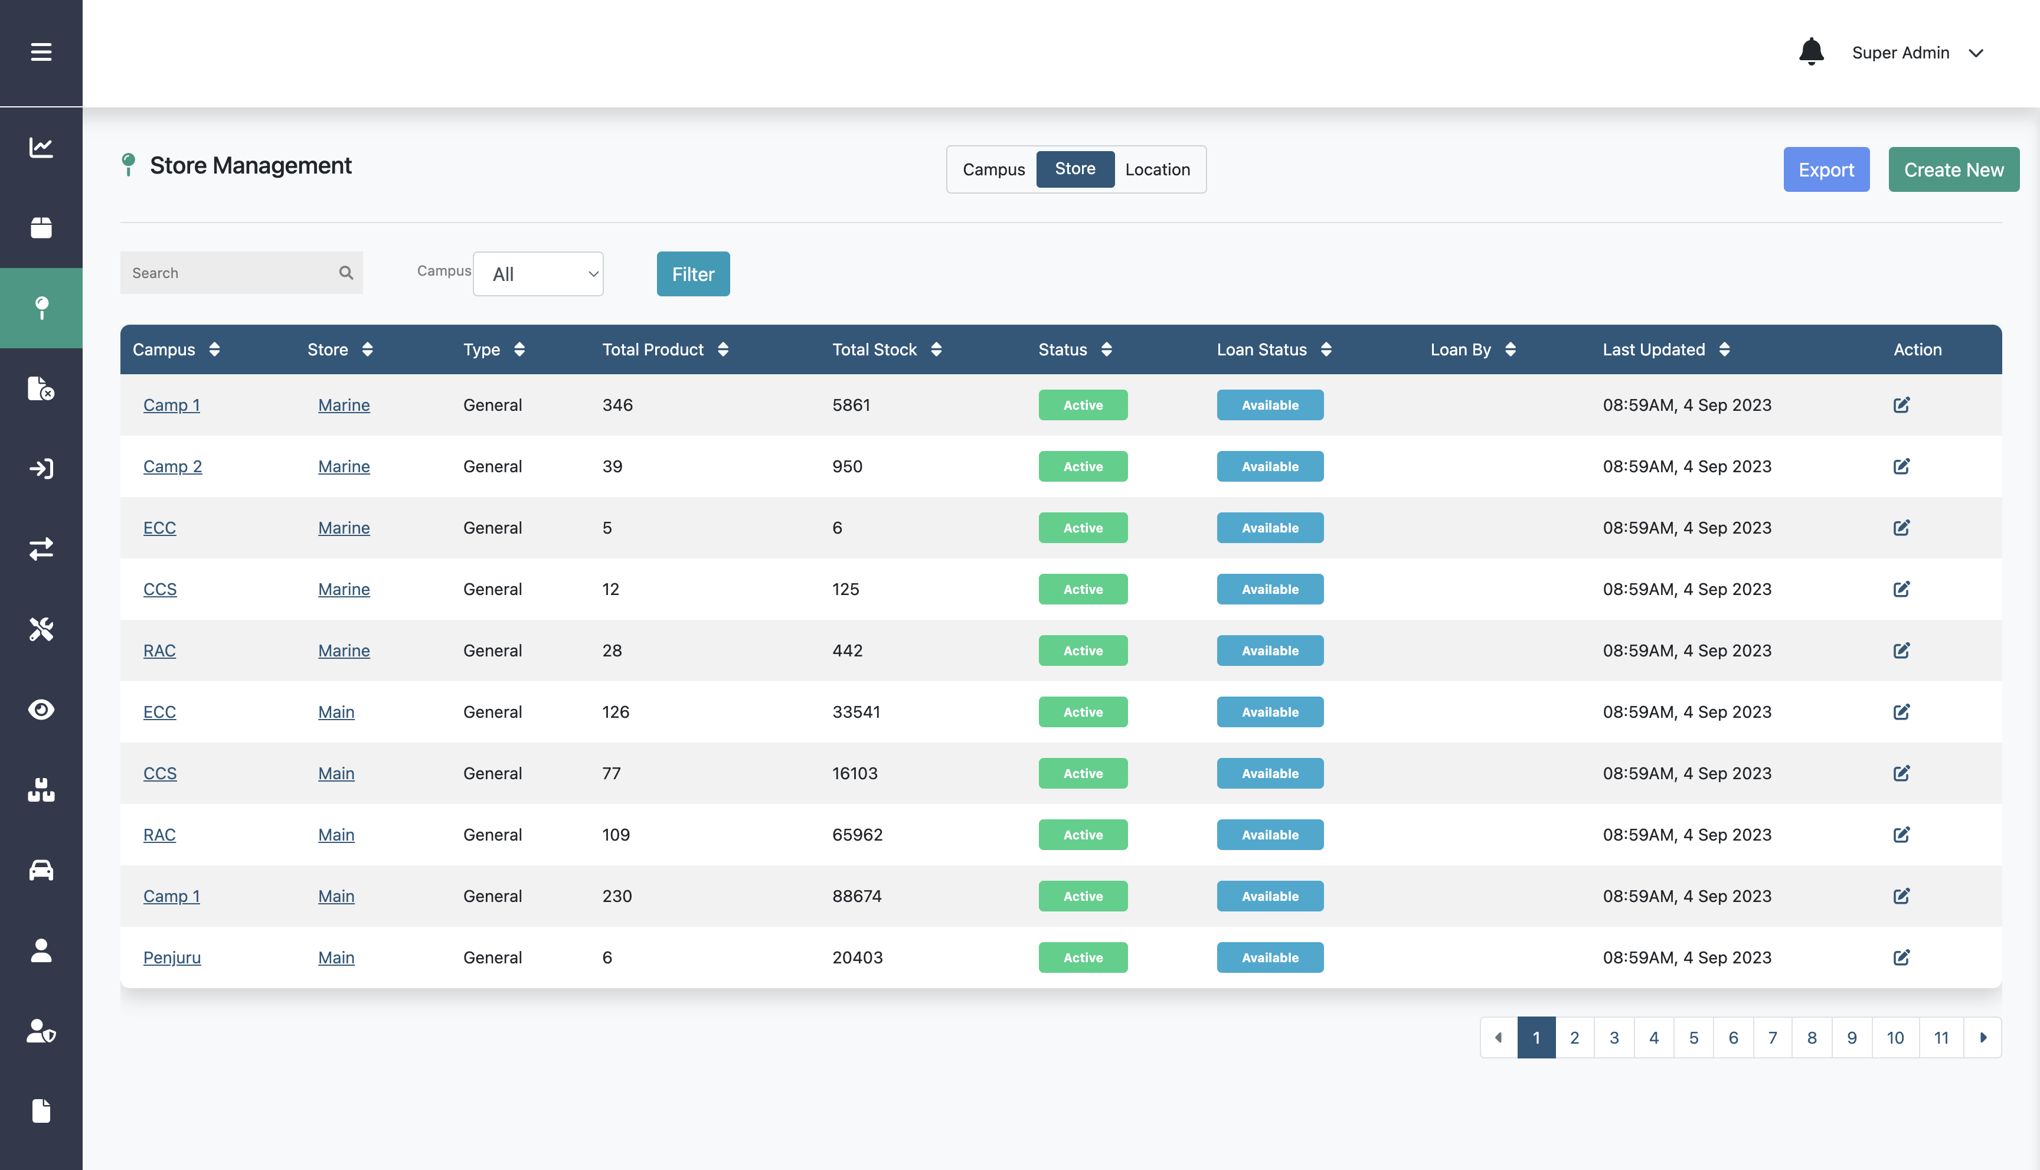
Creating New Store
Step 1:
Step 3:
Click Location menu
Step 2:
Click Store
Click Create New

Slide 81
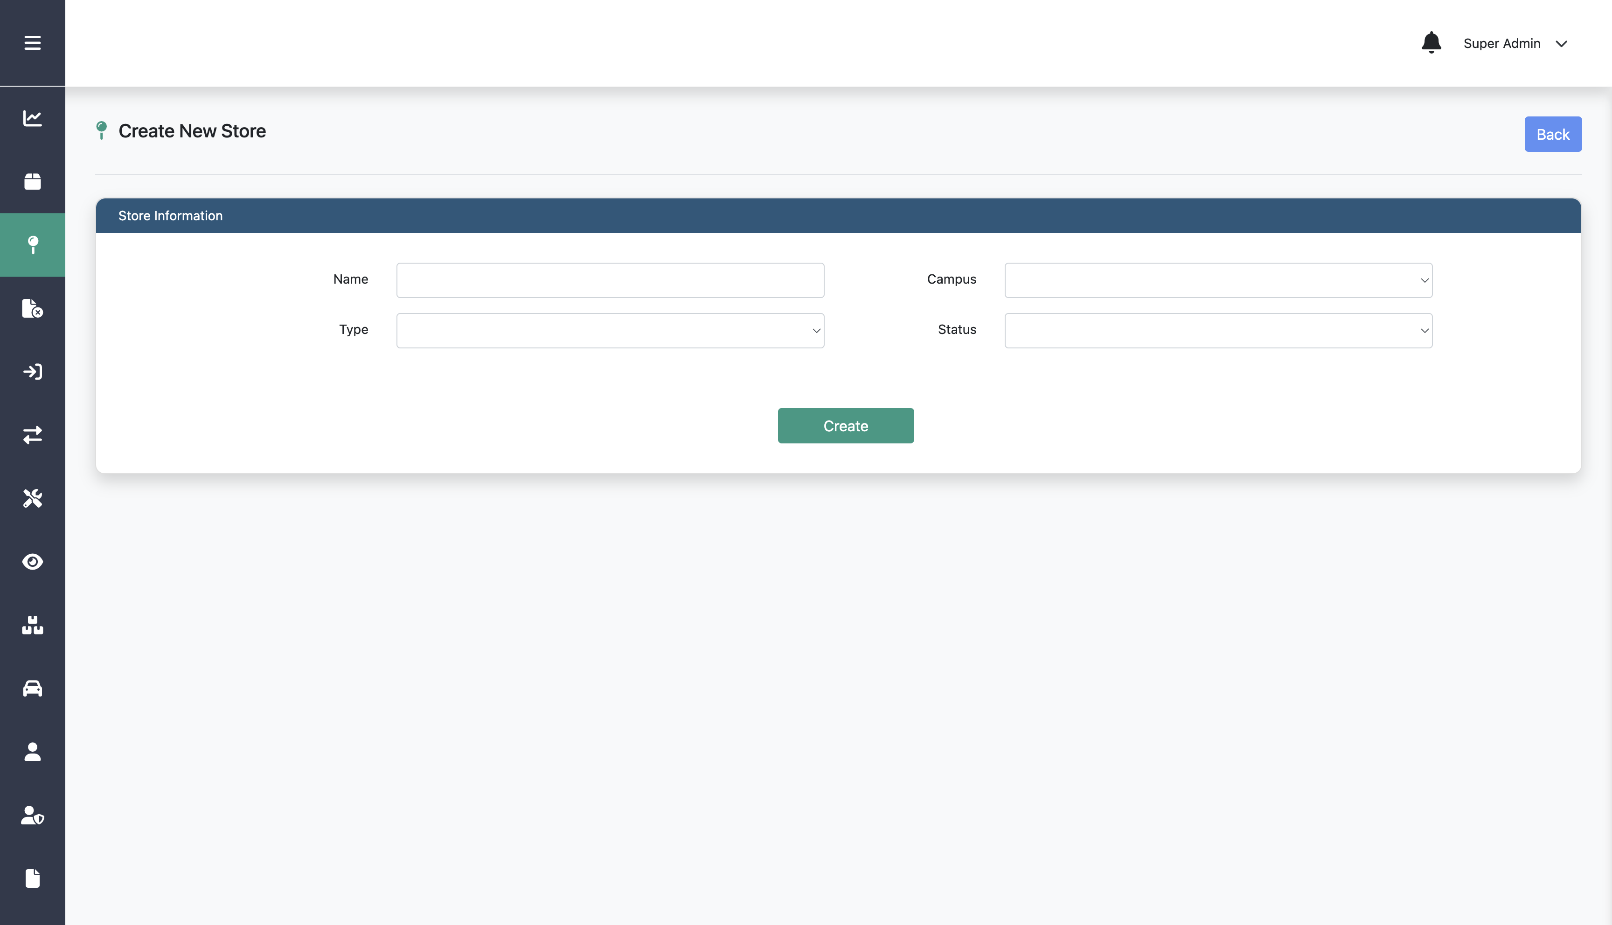
Creating New Store
Step 4:
Fill in name, campus, type, and status
Step 5:
Click Create

Slide 82
Editing Store

Slide 83
Editing Store
Step 1:
Click Location menu
Step 2:
Step 3:
Click Store
Click this edit icon on a specific store

Slide 84
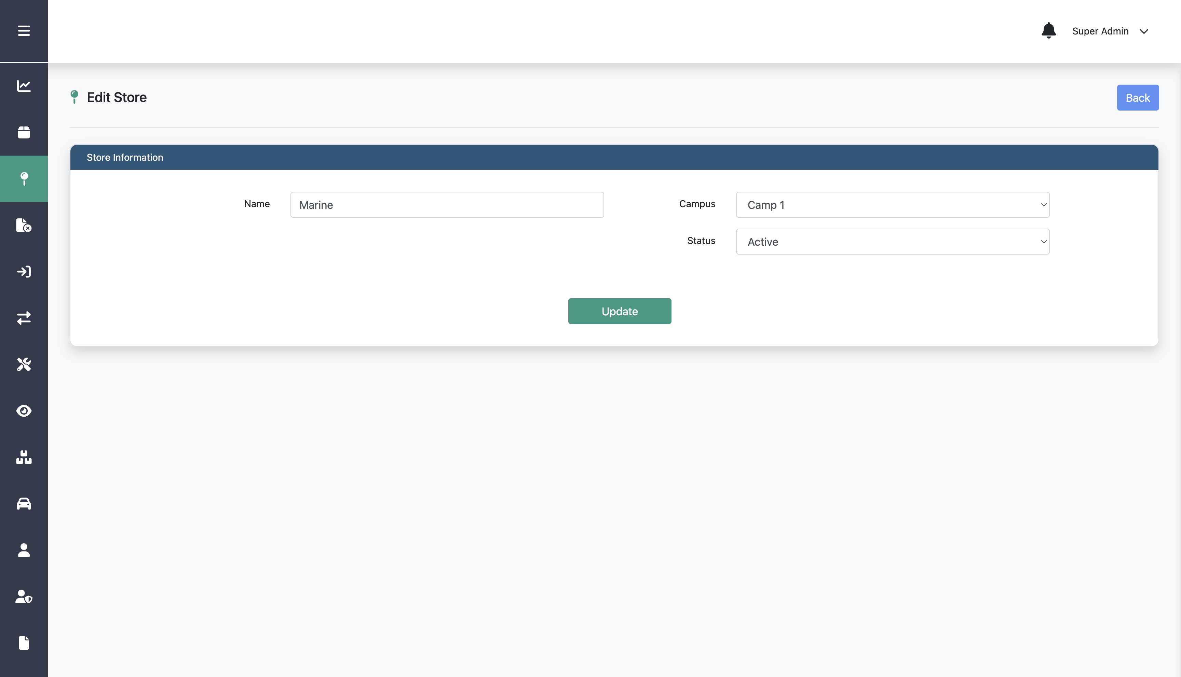
Editing Store
Step 4:
Edit any information on the form
Step 5:
Click Update

Slide 85
Deleting Store

Slide 86
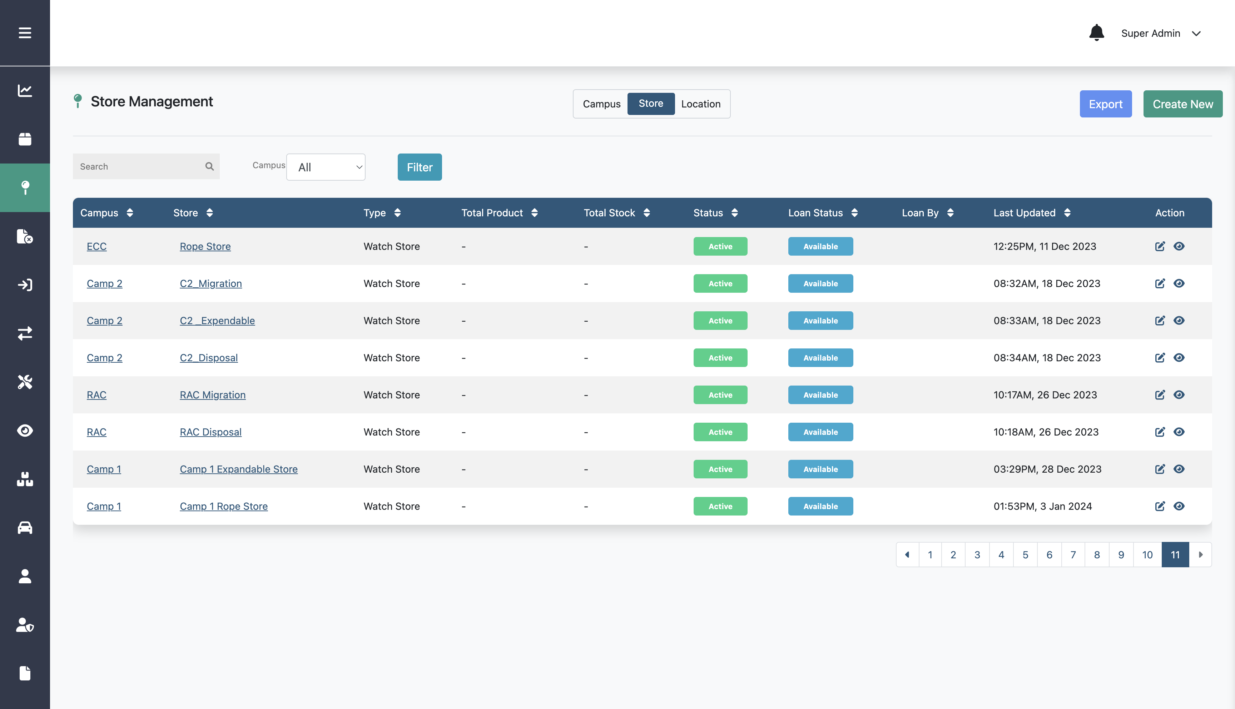
Deleting Store
Step 1:
Click Location menu
Step 2:
Step 3:
Click Store
Click this edit icon on a specific store

Slide 87
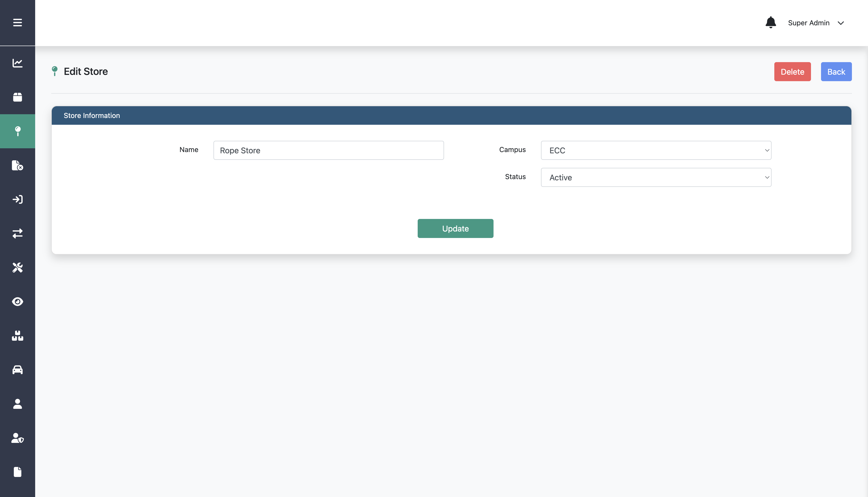
Deleting Store
This Delete button is only available if the store data is not used in any location data
Step 4:
Click Delete

Slide 88
Creating New Campus

Slide 89
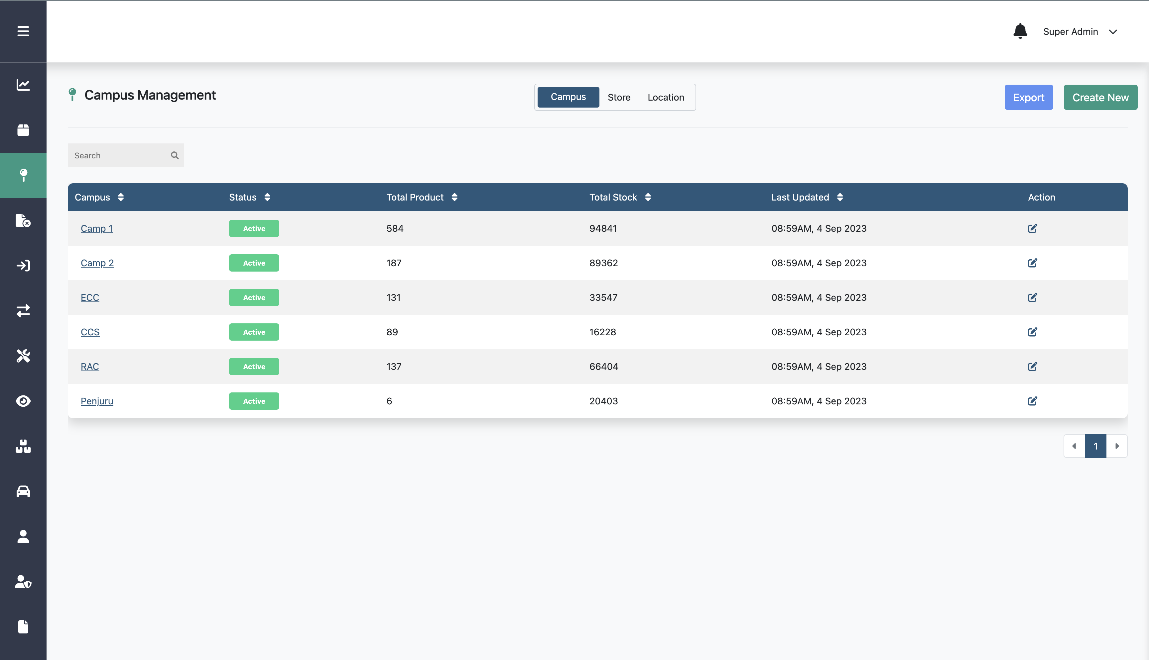
Creating New Campus
Step 1:
Step 3:
Click Location menu
Step 2:
Click Campus
Click Create New

Slide 90
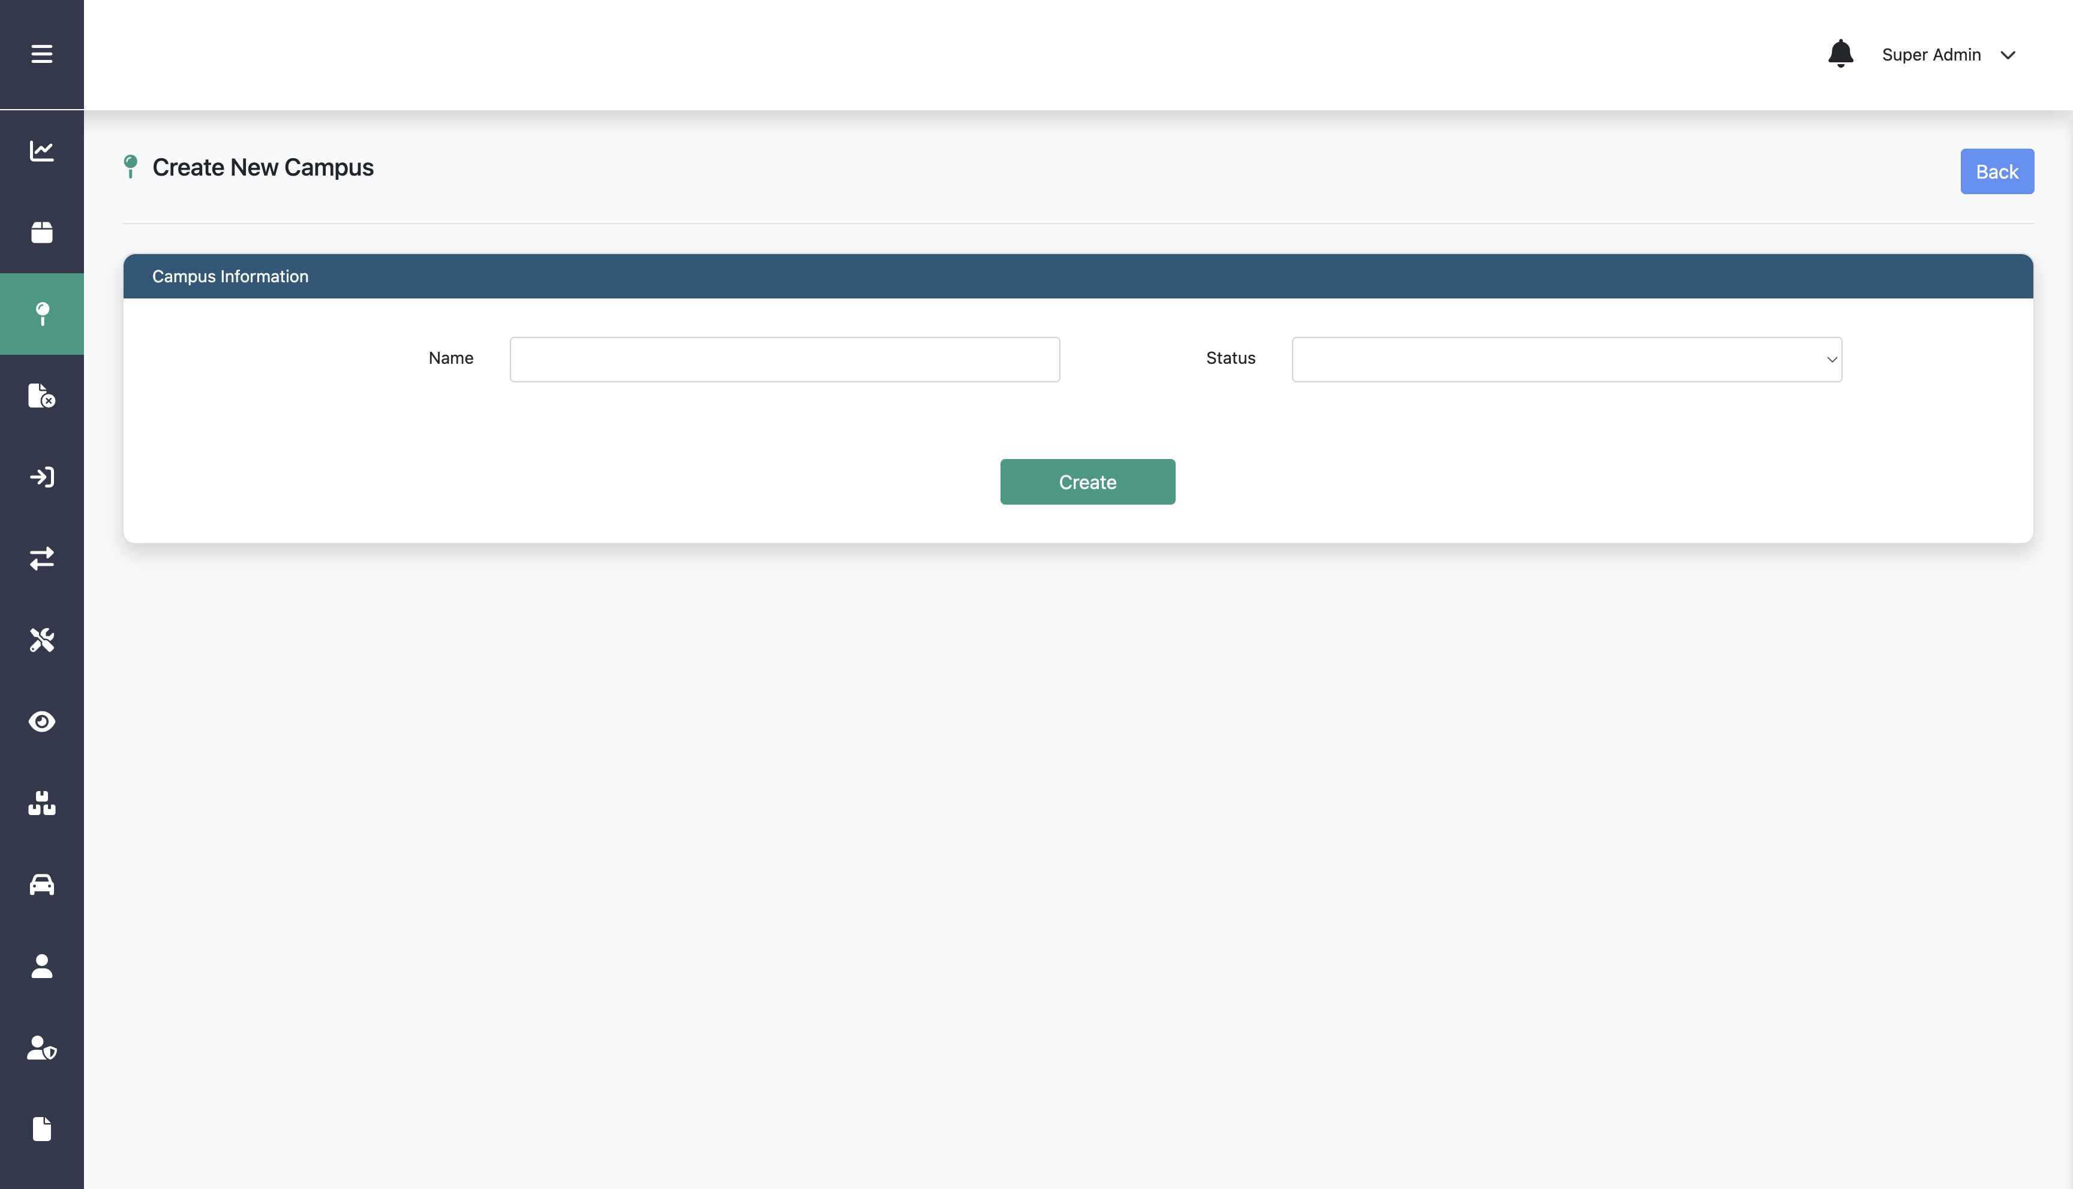
Creating New Campus
Step 4:
Fill in name and status
Step 5:
Click Create

Slide 91
Editing Campus

Slide 92
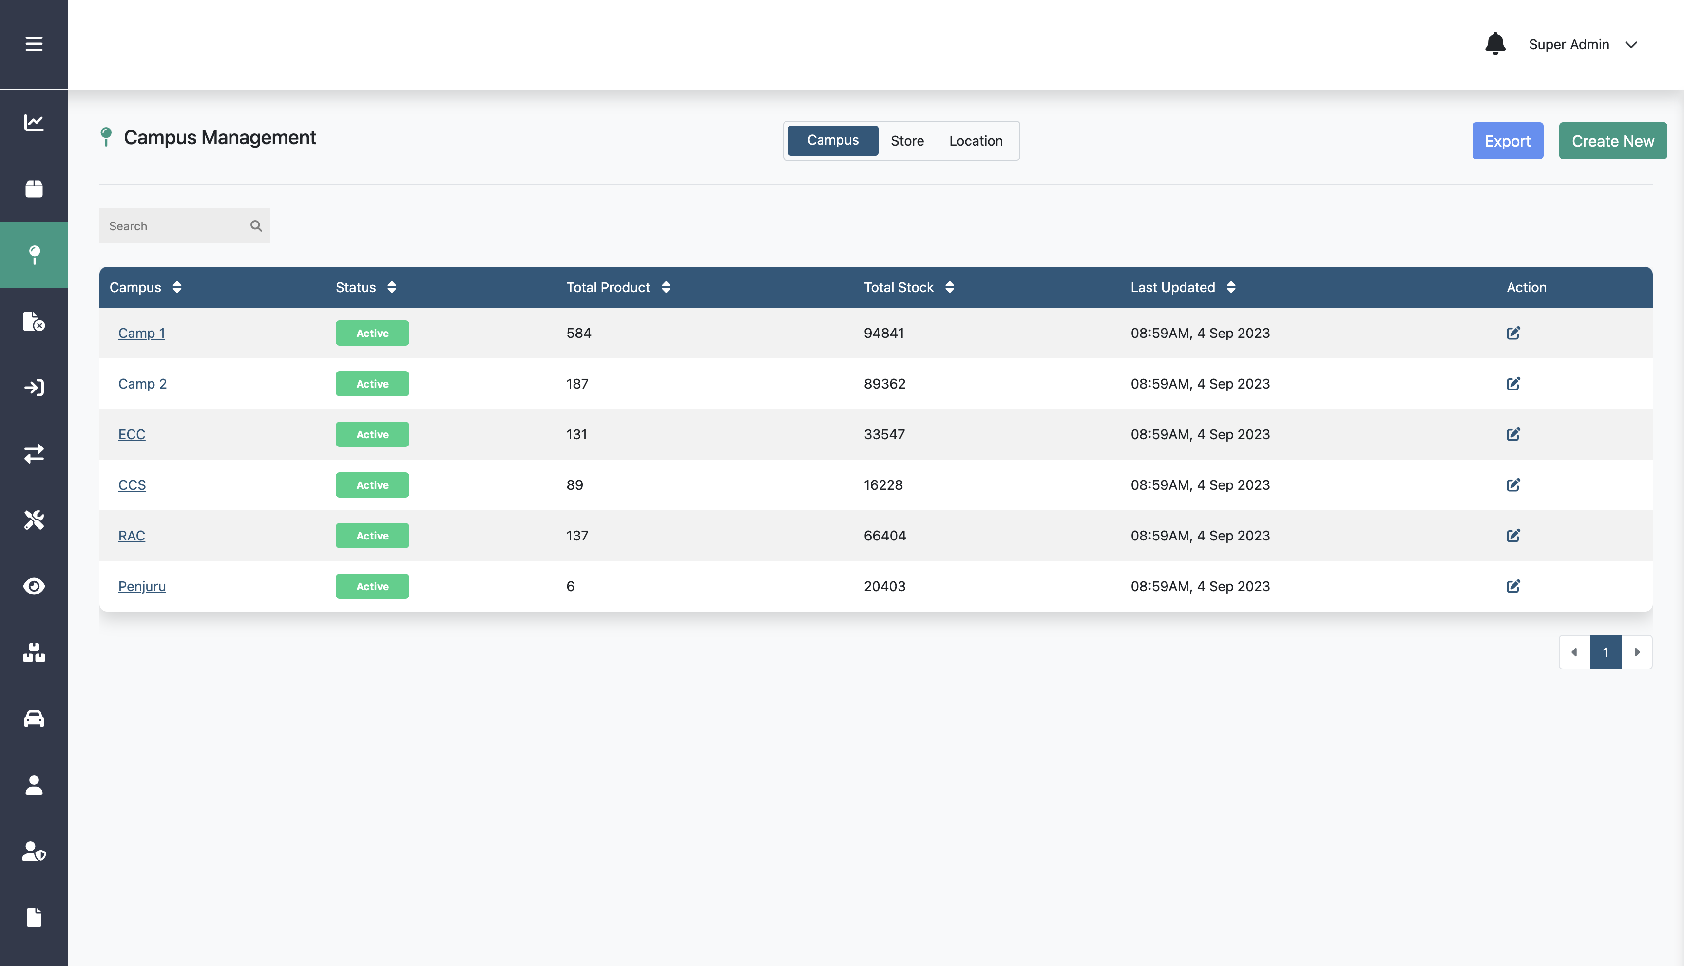
Editing Campus
Step 1:
Click Location menu
Step 2:
Step 3:
Click Campus
Click this edit icon on a specific campus

Slide 93
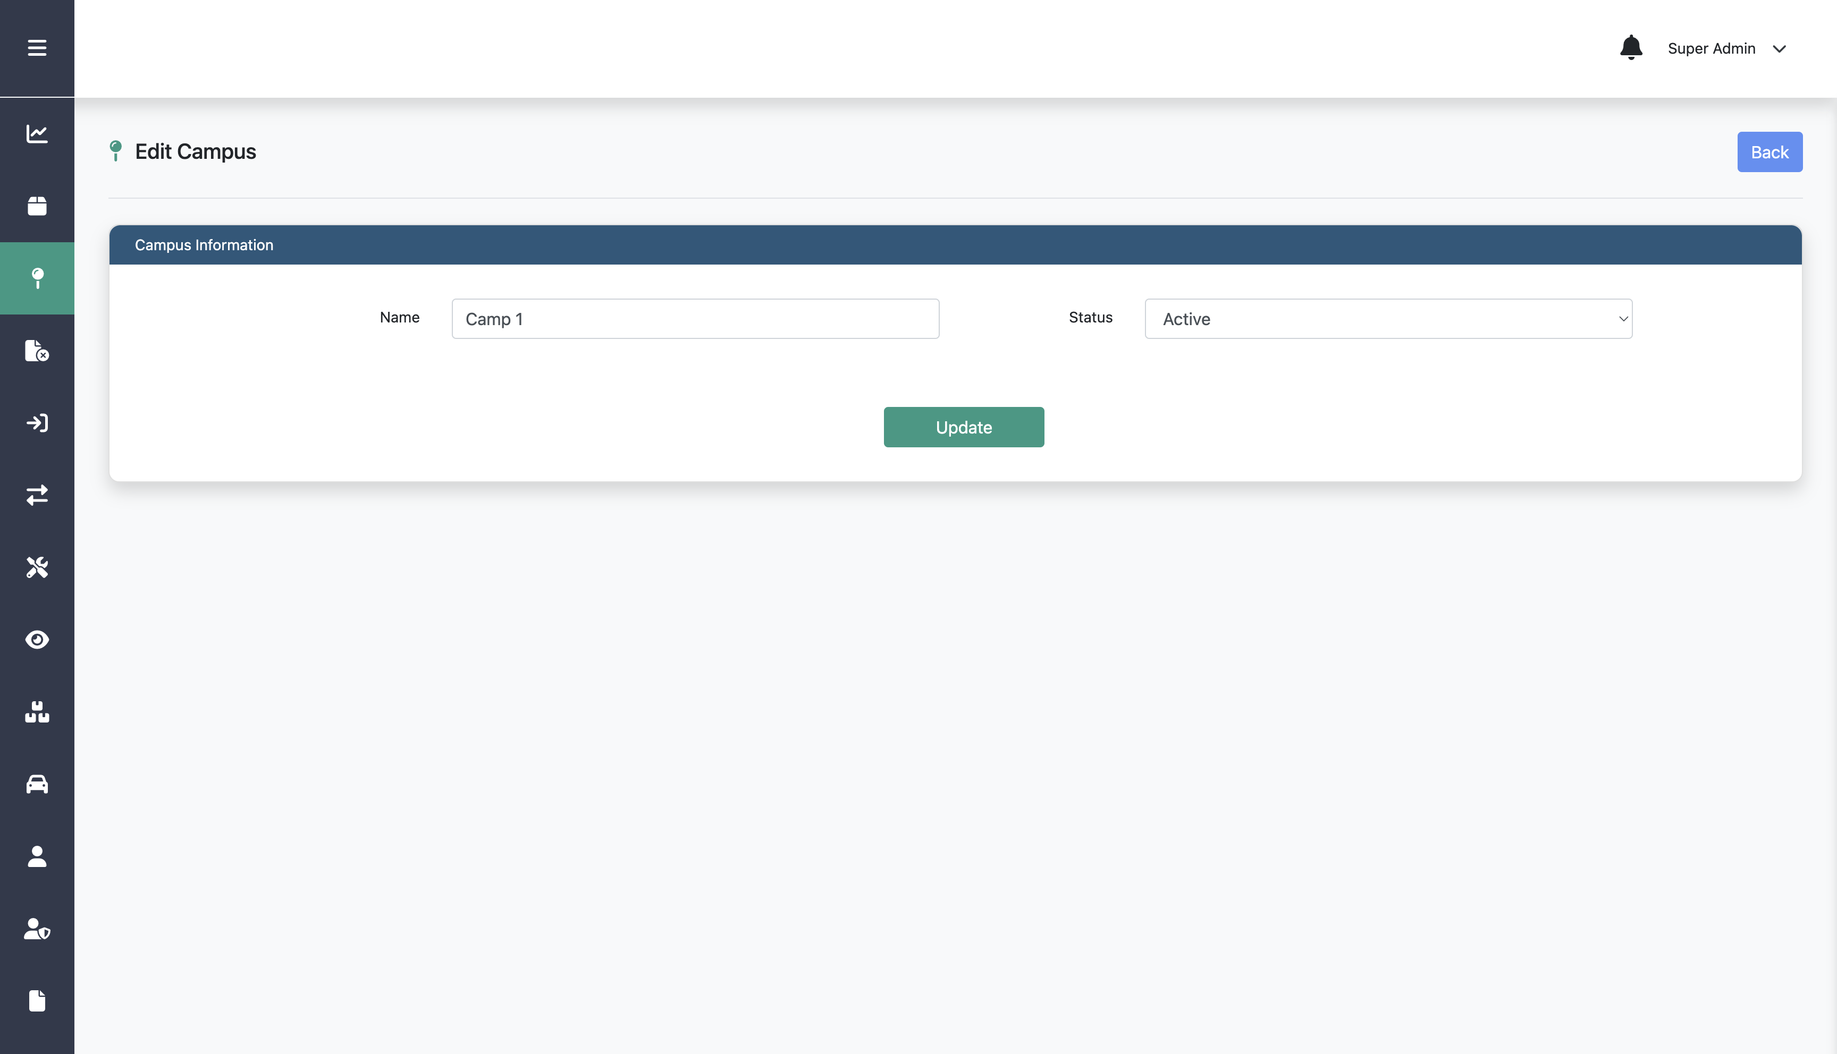
Editing Campus
Step 4:
Edit any information on the form
Step 5:
Click Update

Slide 94
Deleting Campus

Slide 95
Deleting Campus
Step 1:
Click Location menu
Step 2:
Step 3:
Click Campus
Click this edit icon on a specific campus

Slide 96
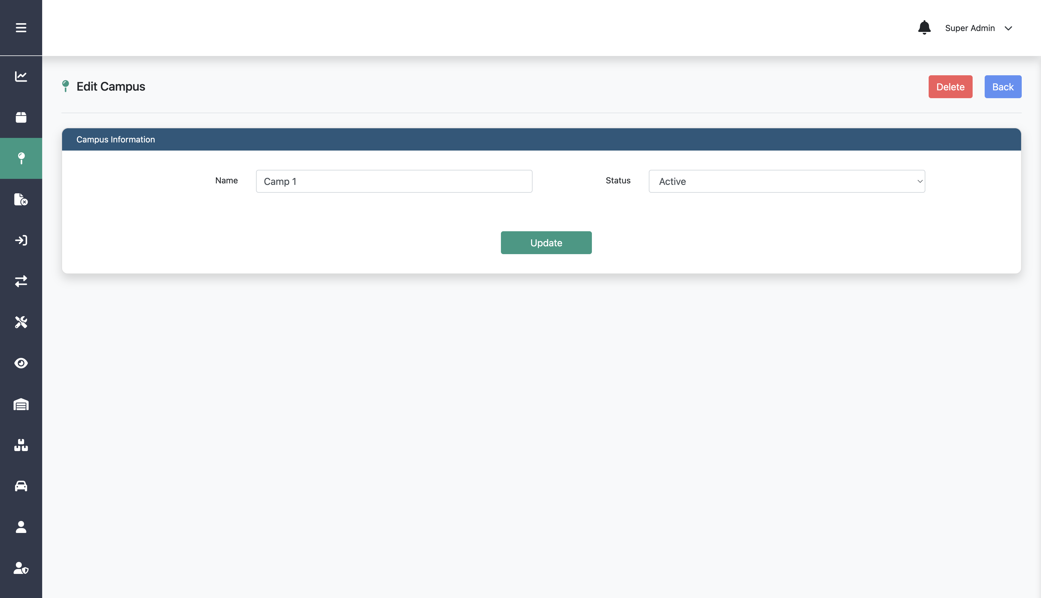
Deleting Campus
This Delete button is only available if the campus data is not used in any store data
Step 4:
Click Delete

Slide 97
Creating New Vehicle

Slide 98
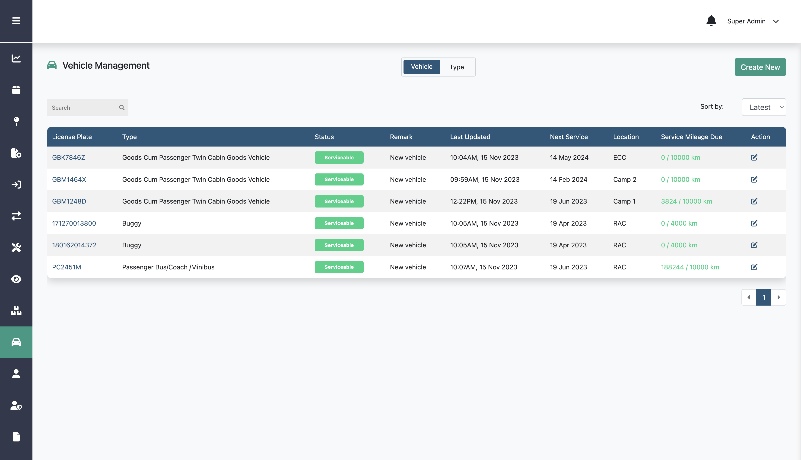
Creating New Vehicle
Step 2:
Click Create New
Step 1:
Click Vehicle menu

Slide 99
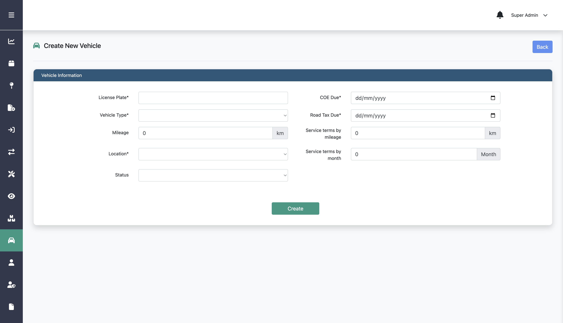
Creating New Vehicle
Step 3:
Fill in license plate, vehicle type, and the other data
Step 4:
Click Create

Slide 100
Editing Vehicle

Slide 101
Editing Vehicle
Step 2:
Click this edit icon on a specific vehicle
Step 1:
Click Vehicle menu

Slide 102
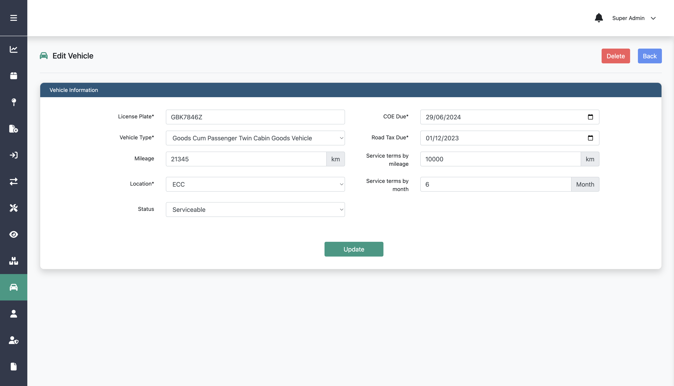
Editing Vehicle
Step 3:
Edit any information on the form
Step 4:
Click Update

Slide 103
Deleting Vehicle

Slide 104
Deleting Vehicle
Step 2:
Click this edit icon on a specific vehicle
Step 1:
Click Vehicle menu

Slide 105
Deleting Vehicle
Step 3:
Click Delete

Slide 106
Creating New Vehicle Type

Slide 107
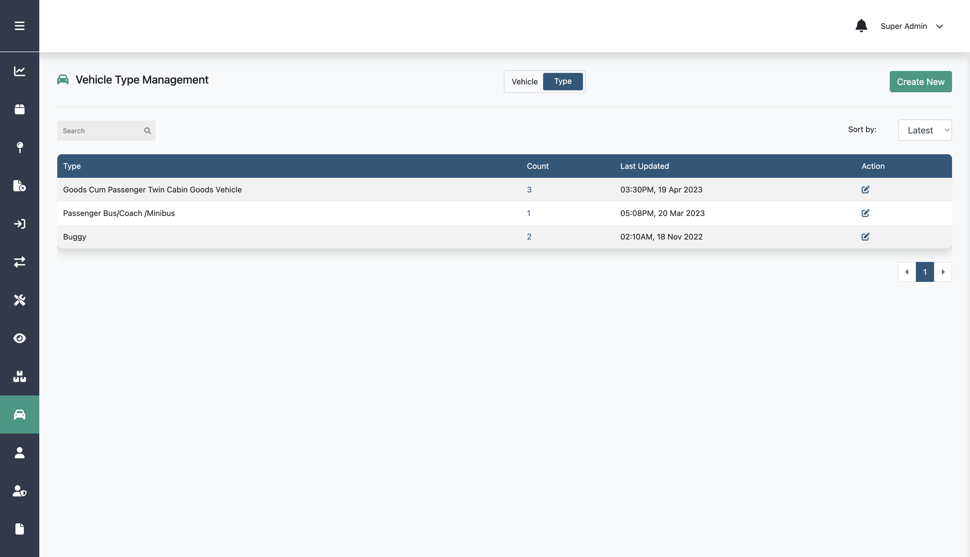
Creating New Vehicle Type
Step 2:
Step 3:
Click Type
Click Create New
Step 1:
Click Vehicle menu

Slide 108
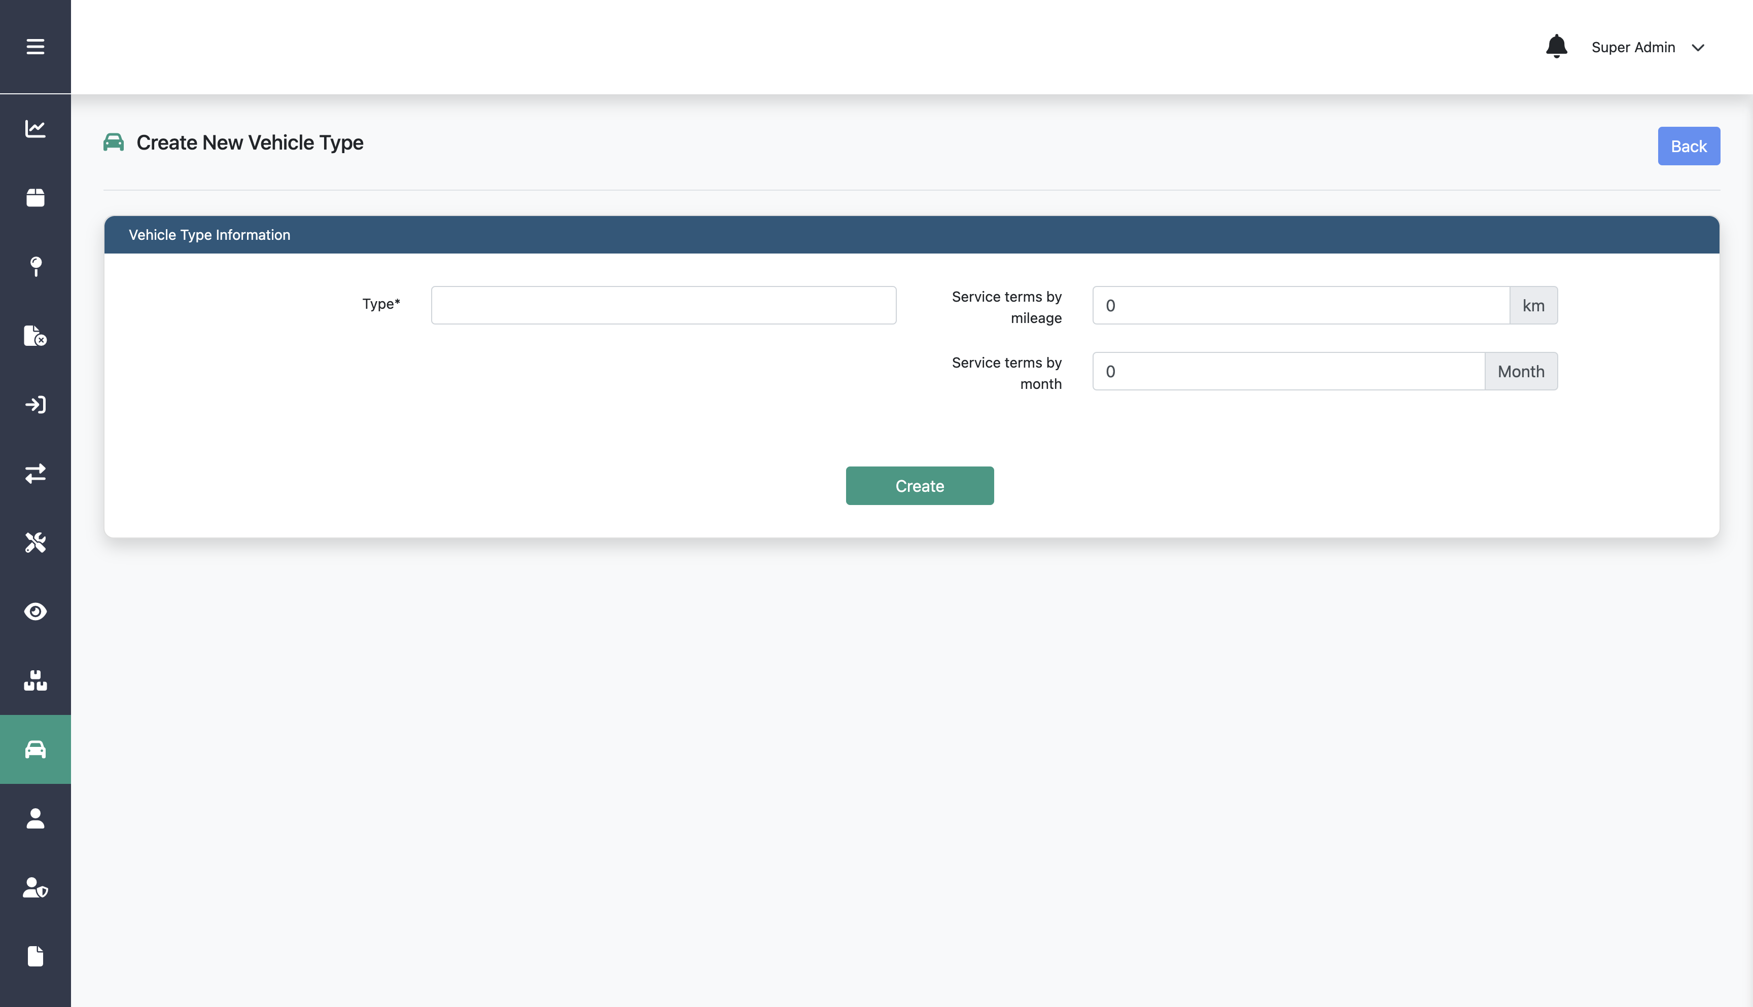
Creating New Vehicle Type
Step 4:
Fill in type, service terms by mileage, and month
Step 5:
Click Create

Slide 109
Editing Vehicle Type

Slide 110
Editing Vehicle Type
Step 2:
Step 3:
Click Type
Click this edit icon on a specific vehicle type
Step 1:
Click Vehicle menu

Slide 111
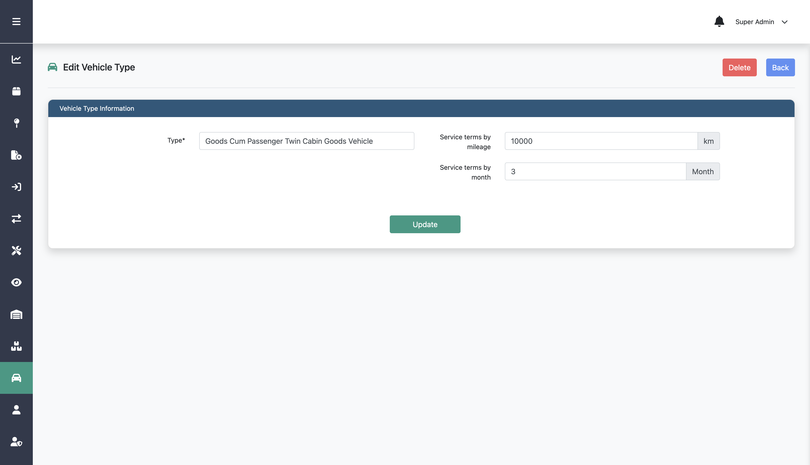
Editing Vehicle Type
Step 4:
Edit any information on the form
Step 5:
Click Update

Slide 112
Deleting Vehicle Type

Slide 113
Deleting Vehicle Type
Step 2:
Step 3:
Click Type
Click this edit icon on a specific vehicle type
Step 1:
Click Vehicle menu

Slide 114
Deleting Vehicle Type
This Delete button is only available if the vehicle type data is not used in any vehicle data
Step 4:
Click Delete

Slide 115
Creating New Inbound

Slide 116
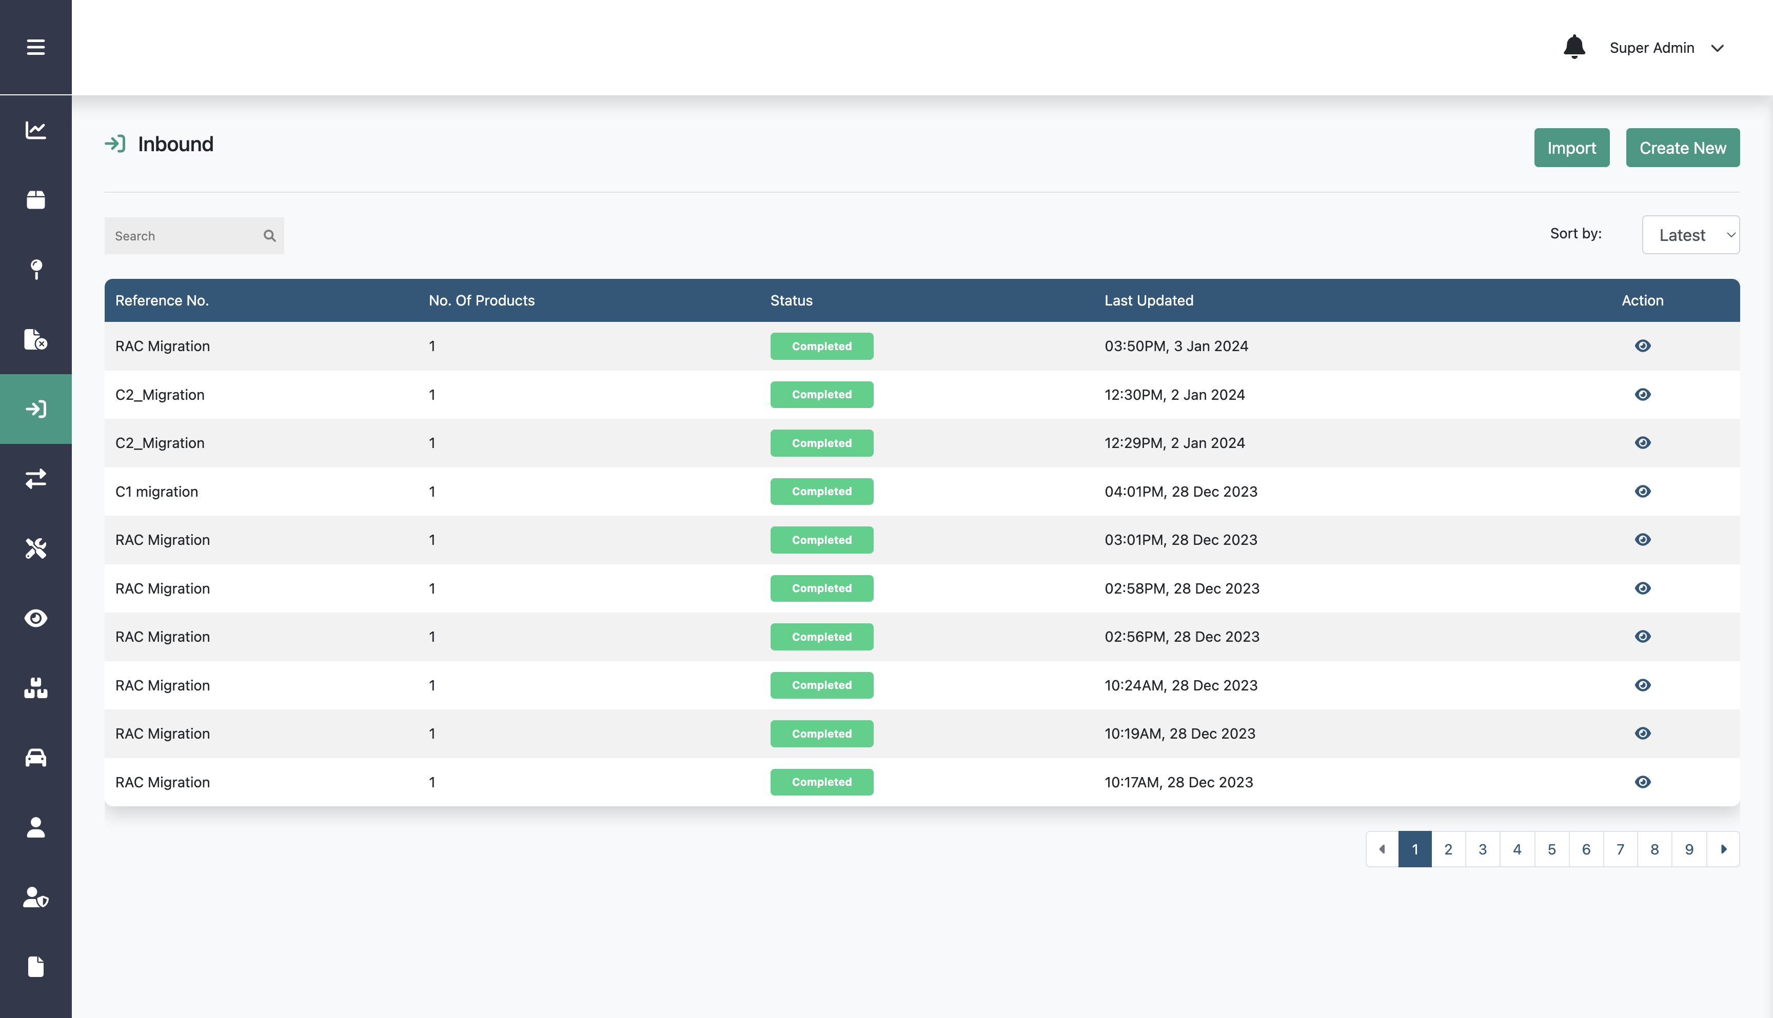
Creating New Inbound
Step 2:
Click Create New
Step 1:
Click Inbound menu

Slide 117
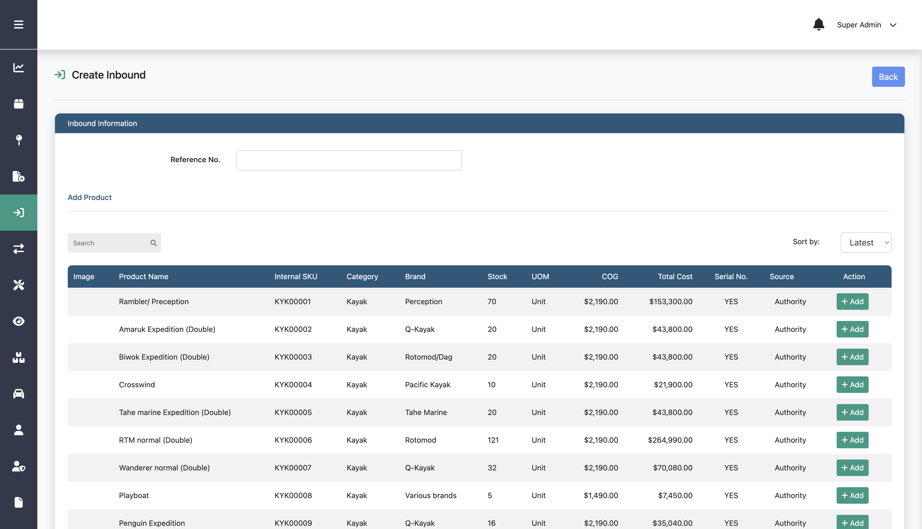
Creating New Inbound
Step 3:
Fill in reference no, add product, and the other data

Slide 118
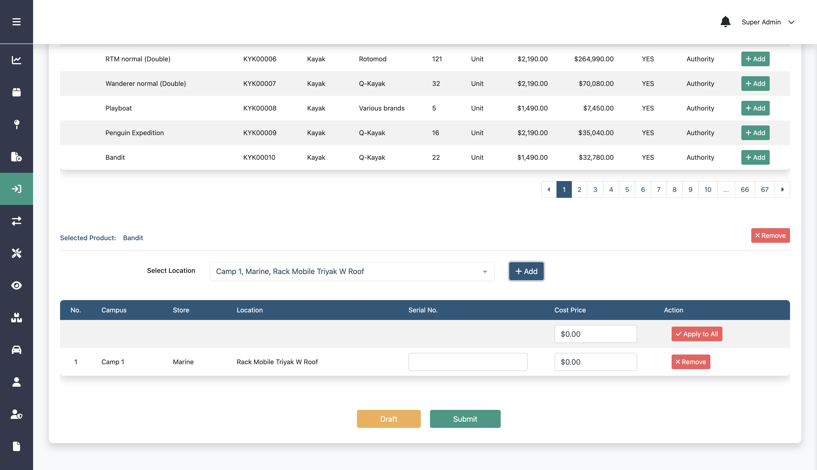
Creating New Inbound
Option:
Step 4:
If the input data is still not finished, you can save it as a draft and you can continue the process later
Click Create

Slide 119
Importing Inbound

Slide 120
Importing Inbound
Step 2:
Click Import
Step 1:
Click Inbound menu

Slide 121
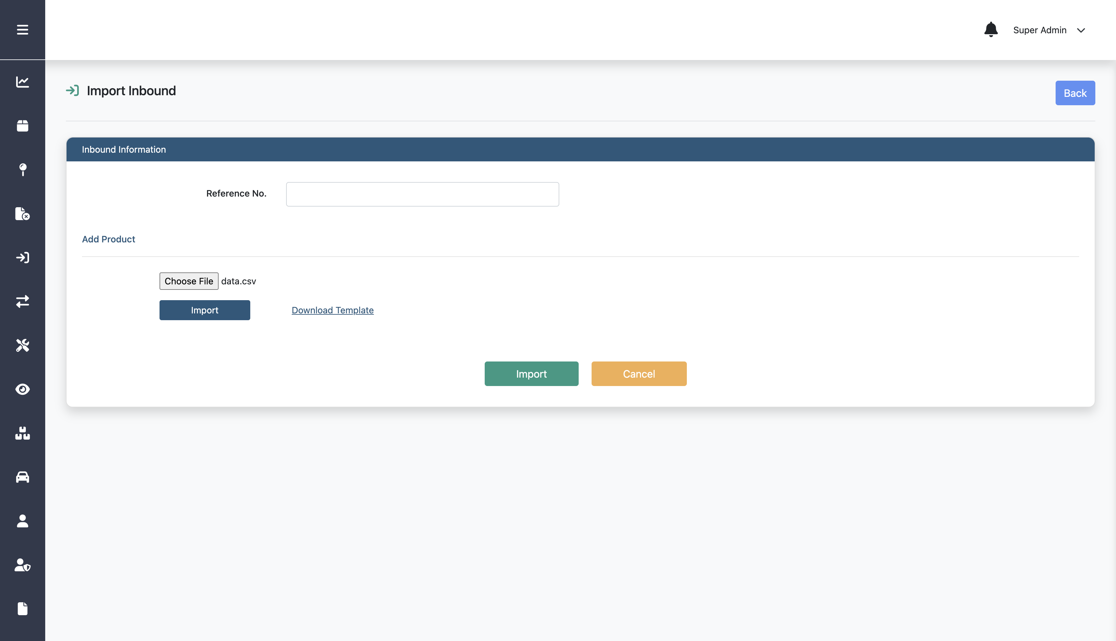
Importing Inbound
Step 3:
Fill in reference no and upload the csv file that include the data
Option:
You can download the csv template
Step 4:
Click Import

Slide 122
Creating Inventory Transfer

Slide 123
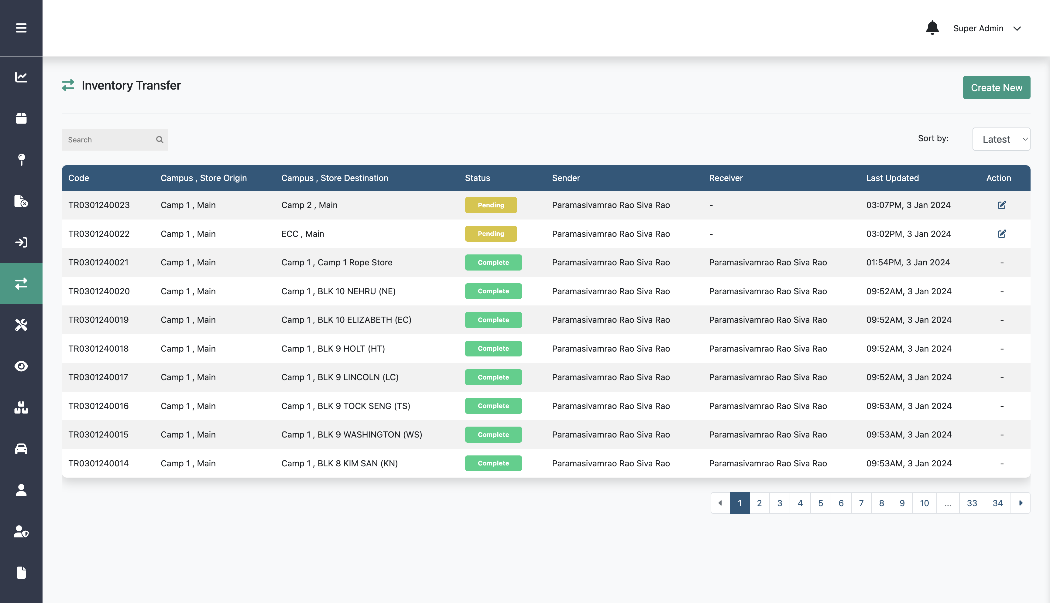
Creating Inventory Transfer
Step 2:
Click Create New
Step 1:
Click Inventory Transfer menu

Slide 124
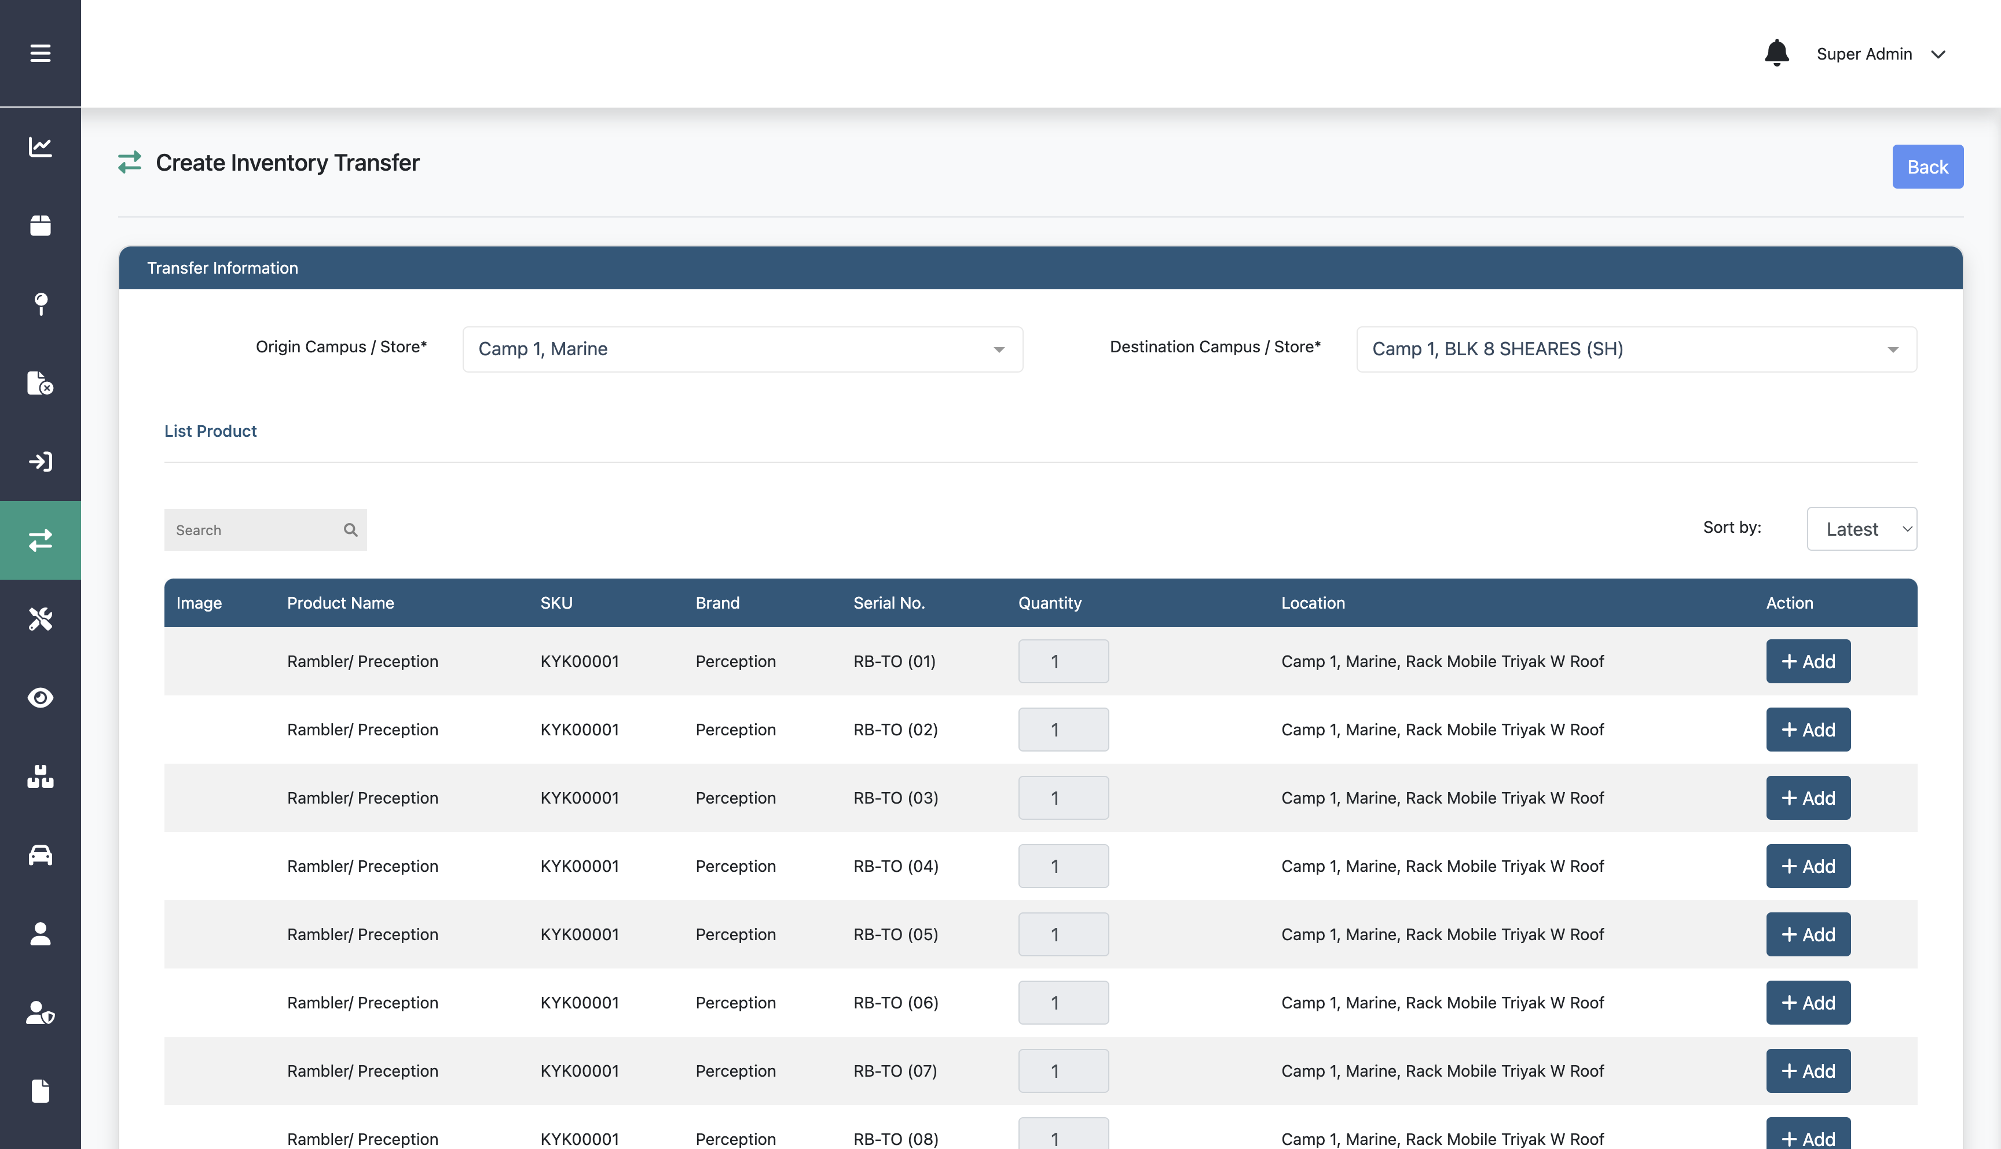
Creating Inventory Transfer
Step 3:
Fill in origin, destination, add product, and the other data

Slide 125
Creating Inventory Transfer
Step 4:
Click Create

Slide 126
Accepting Inventory Transfer

Slide 127
Accepting Inventory Transfer
Step 2:
Click this edit icon on a specific data
Step 1:
Click Inventory Transfer menu

Slide 128
Accepting Inventory Transfer
Step 3:
Fill in destination location field for each data
Step 4:
Option:
Click Accept
You also able to cancel transfer

Slide 129
Creating Maintenance Asset

Slide 130
Creating Maintenance Asset
Step 2:
Click Create New
Step 1:
Click Maintenance menu

Slide 131
Creating Maintenance Asset
Step 3:
Add product
Step 4:
Click Create

Slide 132
Importing Maintenance Asset

Slide 133
Importing Maintenance Asset
Step 2:
Click Import
Step 1:
Click Maintenance menu

Slide 134
Importing Maintenance Asset
Step 3:
Upload the csv file that include the data
Option:
You can download the csv template
Step 4:
Click Import

Slide 135
Setting Upcoming

Slide 136
Setting Upcoming
Step 2:
Click Upcoming
Step 1:
Click Maintenance menu

Slide 137
Setting Upcoming
Step 3:
Set duration on any time frequency
Step 4:
Click Save

Slide 138
Creating Maintenance Job

Slide 139
Creating Maintenance Job
Step 2:
Step 3:
Click Job
Click Create New
Step 1:
Click Maintenance menu

Slide 140
Creating Maintenance Job
Step 4:
Fill in job type, product, and the other data

Slide 141
Creating Maintenance Job
Step 5:
Click Create

Slide 142
Creating Maintenance Job
Step 6:
Complete the data on the form

Slide 143
Creating Maintenance Job
Step 7:
Option:
Click Start Job
You can also cancel the job

Slide 144
Creating Maintenance Condemn

Slide 145
Creating Maintenance Condemn
Step 2:
Step 3:
Click Condemn
Click Create New
Step 1:
Click Maintenance menu

Slide 146
Creating Maintenance Condemn
Step 4:
Step 4:
Fill in job type, product, and the other data
Fill in product, serial no, and the other data
Step 5:
Click Submit and
follow the steps

Slide 147
Creating New Inspection

Slide 148
Creating New Inspection
Step 2:
Click Create New
Step 1:
Click Inspection menu

Slide 149
Creating New Inspection
Step 3:
Add product and the other data

Slide 150
Creating New Inspection
Step 4:
Click Create

Slide 151
Editing Inspection

Slide 152
Editing Inspection
Step 2:
Click this edit icon on a specific inspection
Step 1:
Click Inspection menu

Slide 153
Editing Inspection
Step 3:
Edit any information on the form
Step 4:
Click Update

Slide 154
Importing Inspection

Slide 155
Importing Inspection
Step 2:
Click Import
Step 1:
Click Inspection menu

Slide 156
Importing Inspection
Step 3:
Upload the csv file that include the data
Option:
You can download the csv template
Step 4:
Click Import

Slide 157
Deleting Inspection

Slide 158
Deleting Inspection
Step 2:
Click this delete icon on a specific inspection
Step 1:
Click Inspection menu

Slide 159
Creating New Inspection Job

Slide 160
Creating New Inspection Job
Step 2:
Step 3:
Click Job
Click Create New
Step 1:
Click Inspection menu

Slide 161
Creating New Inspection Job
Step 4:
Step 4:
Fill in job type, product, and the other data
Fill in product, frequency, and the other data
Step 5:
Click Submit

Slide 162
Editing Inspection Job

Slide 163
Editing Inspection Job
Step 2:
Click this edit icon on a specific data
Step 1:
Click Inspection menu

Slide 164
Editing Inspection Job
Step 3:
Edit any information on the form
Step 4:
Click Submit

Slide 165
Creating New Stock Take

Slide 166
Creating New Stock Take
Step 2:
Click Create New
Step 1:
Click Stock Take menu

Slide 167
Creating New Stock Take
Step 4:
Step 3:
Fill in job type, product, and the other data
Fill in campus, store, and the other data
Step 4:
Click Create

Slide 168
Editing Stock Take

Slide 169
Editing Stock Take
Step 2:
Click this edit icon on a specific data
Step 1:
Click Stock Take menu

Slide 170
Editing Stock Take
Step 3:
Edit any information on the form

Slide 171
Editing Stock Take
Step 4:
Click Submit

Slide 172
Discrepancy Report

Slide 173
Discrepancy Report
Step 1:
Step 2:
Click this view icon on a specific data
Click Discrepancy menu

Slide 174
Discrepancy Report

Slide 175
Discrepancy Report
Option:
You can also update the data

Slide 176
Report

Slide 177
Report
The report page is contains summary report, kayak, bicycle, and other report data that can be downloaded in xlsx file

